Slide 1
Računalniški praktikum I – IKT storitve Computer Practicum I – ICT Services
Vida Groznik, Matjaž Kljun

Slide 2
Računalniški praktikum I
Vida Groznik, Niki Hrovatin, Domen Vake

Slide 3
Splošne informacije / General Information
Izvajalci: / Lecturers:
doc. dr. Vida Groznik (vida.groznik@famnit.upr.si)
as. Niki Hrovatin (niki.hrovatin@famnit.upr.si)
as. Domen Vake (domen.vake@famnit.upr.si)
Govorilne ure: po dogovoru / Office hours: by appointment
Pisarna: / Office: @ Kettejeva 1

Slide 4
O predmetu / About
Predavanja|vaje / Lectures|lab work:
1. skop: / 1st part: Linux, bash, LaTeX (Vida Groznik, Niki Hrovatin)
2. sklop: / 2nd part: programski jezik C (Domen Vake, Niki Hrovatin)
Razpored po skupinah za vse predmete je objavljen na FAMNIT-ovi spletni strani: https://www.famnit.upr.si/sl/resources/files/urniki/studenti.xls
The group schedule for all subjects is published on the FAMNIT website: https://www.famnit.upr.si/sl/resources/files/urniki/studenti.xls

Slide 5
O predmetu / About
Ocenjevanje: / Grading:
Domače naloge – 30 % končne ocene / Homeworks – 30% of final grade
Izpit ali 2 kolokvija – 70% končne ocene / Final exam or 2 midterms – 70% of final grade
Za uspešno opravljen predmet morate zbrati ≥ 50% točk pri končni oceni / You must get ≥ 50% of points for final grade to pass the class
Domače naloge – 30% končne ocene / Homeworks – 30% of final grade
3 domače naloge, ne zamujajte z oddajo (zamuda do 7 dni za posamezno nalogo – max 80% možnih točk; več kot 7 dni – 0 točk)! / 3 homeworks, don‘t be late with the submissions! (if up to 7 days late per HW – max 80% of the points, more than 7 days – 0 points!)
Za pristop k izpitu morate pri domačih nalogah doseči vsaj 10% končne ocene! / You need to get at least 10% of the final grade from homeworks to be eligible to sit the exam!

Slide 6
O predmetu / About
Izpit – 70% končne ocene / Final exam – 70% of final grade
Za uspešno opravljen izpit, morate zbrati vsaj 50% vseh možnih točk na izpitu / in order to pass the final exam, you need to get at least 50% of all of the points on the final exam
Predmet lahko namesto z izpitom opravite z dvema kolokvijema tekom semestra (povprečje točk na kolokvijih vsaj 50%; posamezen kolokvij najmanj 30%) / In order to pass, you need to get at least 50% of all (or at least an average of 50% points of midterms; individual midterm at least 30%)
Za uspešno opravljen predmet morate zbrati ≥ 50% točk pri končni oceni / You must get ≥ 50% of points for final grade to pass the class

Slide 7
Kolokviji / Midterms
1. kolokvij: / 1st Midterm: Ponedeljek, 15. 11. 2021 / Monday, 15 November 2021
2. kolokvij: / 2nd Midterm: Ponedeljek, 17. 1. 2022 / Monday, 17 January 2022

Slide 8
Komunikacija z zaposlenimi na fakulteti / Communication with the faculty staff
Kako komuniciramo preko e-maila? / How to communicate via e-mail?
VEDNO uporabljajte uradni študentski e-mail naslov / ALWAYS use official student e-mail address
Ne uporabljajte slenga! / Do not use slang!
Zaposlene naslovite z njihovim polnim imenom oz. vsaj s priimkom, npr.: Spoštovani profesor Branko Kavšek; Spoštovana doc. Groznik; Address the employees with their full names or at least with their surname, eg: Dear Professor Branko Kavšek; Dear doc. Groznik;
Zaposlenih NE tikate!
Nevtralen odnos / Neutral attitude

Slide 9
Komunikacija z zaposlenimi na fakulteti / Communication with the faculty staff
Kako komuniciramo preko e-maila? / How to communicate via e-mail?
6. Struktura sporočila / Structure
Jasna tema / Clear subject
Vljuden pozdrav / Polite greeting
Predstavite se / Introduce yourself
Opis težave / Description of the issue
Kaj ste do sedaj naredili za razrešitev težave / What have you done by now to address the issue
Kako vam lahko pomagam / How can I help
Zaključek / Wrap up
Podpis / Signature

Slide 10
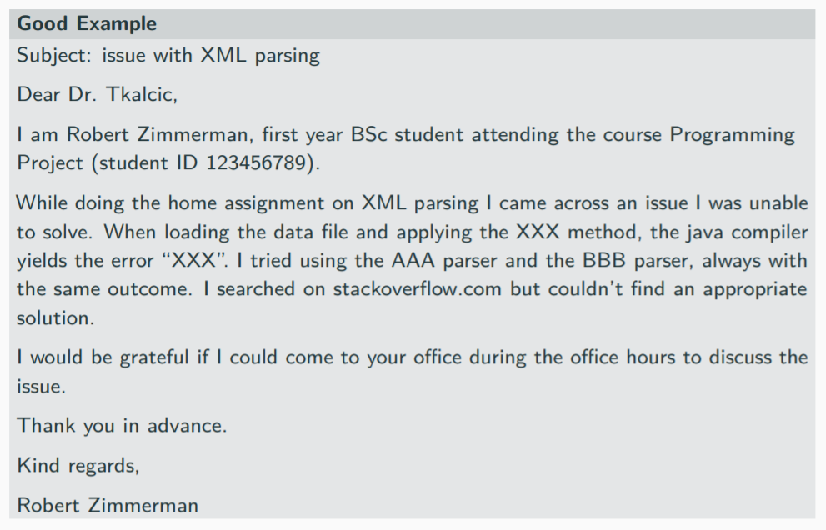
Komunikacija z zaposlenimi na fakulteti / Communication with the faculty staff

Slide 11
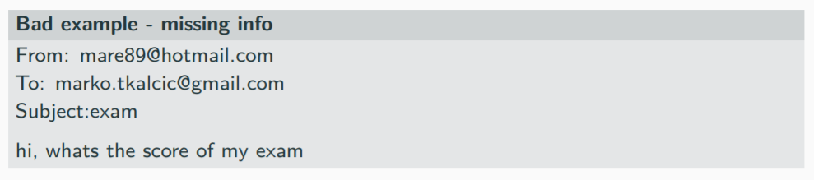
Komunikacija z zaposlenimi na fakulteti / Communication with the faculty staff

Slide 12
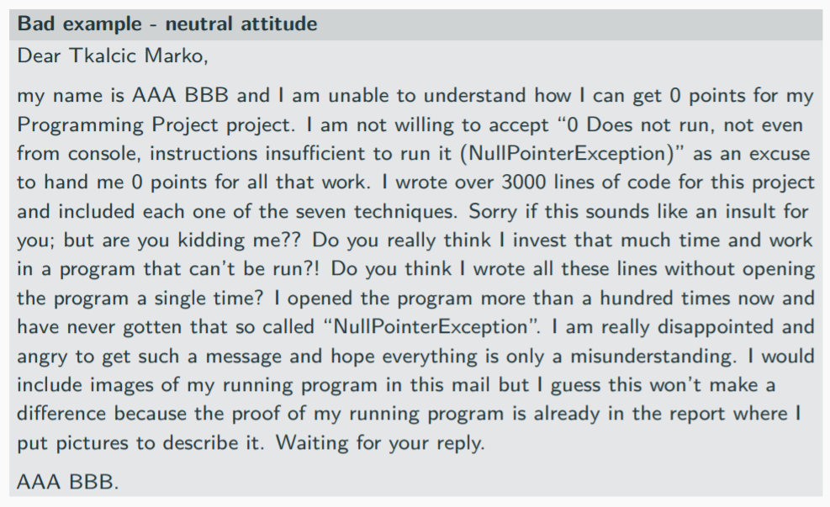
Komunikacija z zaposlenimi na fakulteti / Communication with the faculty staff

Slide 13
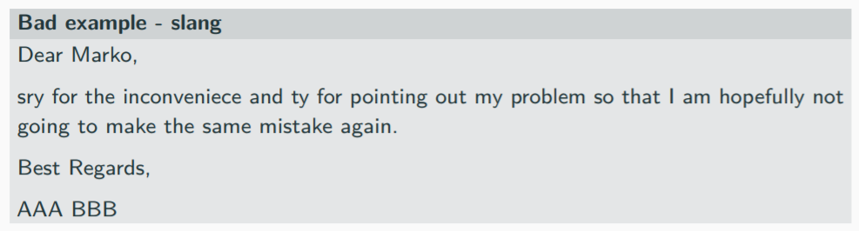
Komunikacija z zaposlenimi na fakulteti / Communication with the faculty staff

Slide 14
IKT storitve / ICT services
Spletna stran
Študentski Informacijski Sistem (ŠIS)
Akademski koledar
Urniki
E-pošta
Eduroam
Arnes AAI
Office 365
VPN
Študentska obvestila
Oddaljen dostop (SSH)
E-učilnice (Moodle)
ZOOM
Web page
Student Information System (SIS)
Academic calendar
Timetables
E-mail
Eduroam
Arnes AAI
Office 365
VPN
Student office notifications
Remote access (SSH)
E-classrooms (Moodle)
ZOOM

Slide 15
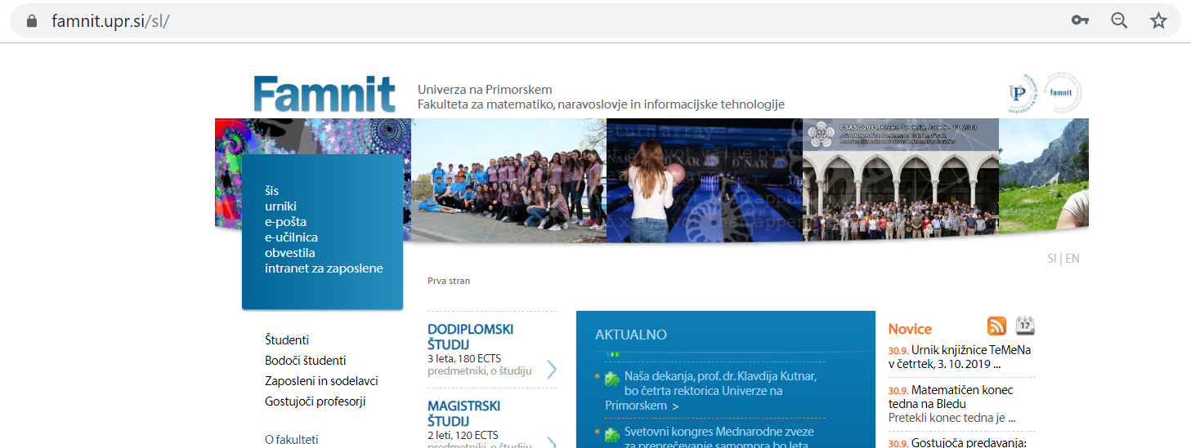
FAMNIT spletna stran / FAMNIT web page
www.famnit.upr.si

Slide 16
Študentski informacijski sistem – ŠIS / Student Information System - ŠIS
https://vis.upr.si/famnit/ ali iz FAMNIT-ove spletne strani:
https://www.famnit.upr.si/sl/sis
https://vis.upr.si/famnit/ or from FAMNIT web page:
https://www.famnit.upr.si/sl/sis
Izpitni roki
Prijava na izpite/kolokvije
Rezultati izpitov/ocene
Vpis v posamezen letnik
Obrazci (pogojni vpis ...)
Študentska anketa
Exame dates
Applying for exams
Exam results / grades
Enrollment in next year
Application forms (conditional enrollment …)
Student survey

Slide 17
Dodatno / In addition
Držite se rokov!
Če se ne prijavite pravočasno na izpit NE MOREMO (predavatelji, asistenti) NAREDITI NIČESAR = ste pač preskočili en rok.
Pri vsakem predmetu lahko opravljate izpit LE ŠESTKRAT. Trikrat brez komisije in trikrat s komisijo. Ne zapravljati rokov s poskušanjem!
Če se ne odjavite od izpita in ne pridete pisati, vas predavatelj lahko oceni z “ni pristopil” in ne morete na naslednji rok.
Follow the deadlines!
If you don’t enrol for exams as by the rules WE (lecturers, teaching assistants) CANNOT DO ANYTHING = you missed that exam and you can enrol to the next.
For each course you can take an exam SIX TIMES ONLY. Three times without and three times with a committee. Do not waist exams by trying!
If you do not unenroll from the exam and do not come to write, the lecturer may grade you with “did not show up” and you cannot enrol for the next one.

Slide 18
Študijski koledar / Academic Calendar
Študijski koledar / Academic calendar:
Slovenski: https://www.famnit.upr.si/sl/studenti/studijski-koledar/studijski-koledar-21-22
English: https://www.famnit.upr.si/en/education/general-information/ac21-22
Bolj detaljno (PDF) / In more detail (PDF):
Slovenski: https://www.famnit.upr.si/sl/resources/files/studenti/studijski-koledar/01studkoledarup2021-22pregldelinprostihdni.pdf
English: https://www.famnit.upr.si/en/resources/files/education/general-information/ac21-22/02studkoledarup2021-22pregldelinprostihdni-ang.pdf
Stenski koledar (PDF) / Wall calendar (PDF) Slovenski: https://www.famnit.upr.si/sl/resources/files/studenti/studijski-koledar/studijski-koledar-21-22.pdf

Slide 19
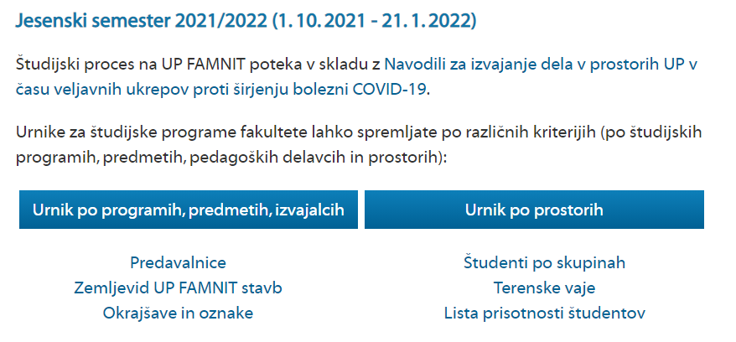
Urniki / Timetables
https://www.famnit.upr.si/sl/urniki
https://www.famnit.upr.si/en/student-pages/timetables

Slide 20
Dodatno / In addition
Urnik se lahko spremeni, zato si ga poglejte, preden pridete na predavanja/vaje
Lahko se spremeni le predavalnica v kateri se bodo izvajala predavanja in/ali vaje (ni nujno, da imate cel semester vaje/predavanja enega predmeta v isti predavalnici)
Sledite obvestilom referata in obvestilom predavateljev in asistentov pri posameznem predmetu preko e-učilnice (več kasneje).
The schedule may change, so check it out before you come to the lectures/practicals.
The change may only involve the lecture hall where the lectures and/or tutorials will take place (it is not necessary that one course will take place in the same lecture hall for the whole semester).
Follow the notices of the the student office as well as notices of lecturers and teaching assistants for each subject via the e-classroom (more later).

Slide 21
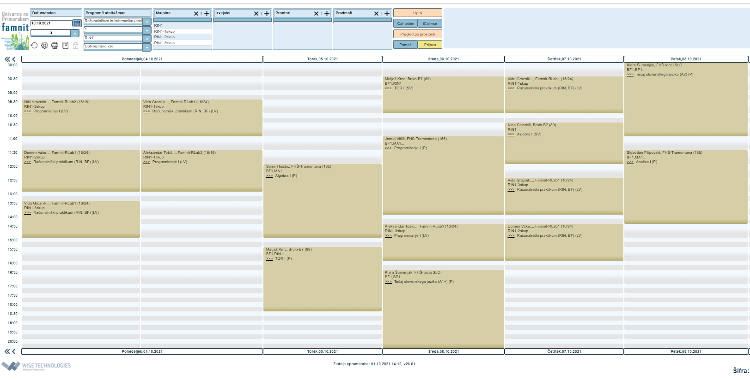
Urniki predmetov

Slide 22
Elektronska pošta / E-mail
Office 365 portal: portal.office.com
Uporabniško ime: studentID@student.upr.si
Geslo: enako kot ste ga prejeli za ŠIS
Če ste spremenili geslo za ŠIS, je zelo verjetno, da geslo za elektronsko pošto ni bilo spremenjeno - preveri!
E-poštni naslov: studentID@student.upr.si
Navodila, za nastavitve poštnega odjemalca: https://medium.com/@neurosnap/how-to-send-and-receive-email-using-gmail-or-inbox-from-outlook-office365-64c0c4ecccf8
Office 365 portal: portal.office.com
Username: studentID@student.upr.si
Password: the same as for the ŠIS
If you changed your SIS password, it is very likely that the email password has not been changed - check!
E-mail address: studentID@student.upr.si
Instructions for e-mail client settings: : https://medium.com/@neurosnap/how-to-send-and-receive-email-using-gmail-or-inbox-from-outlook-office365-64c0c4ecccf8

Slide 23
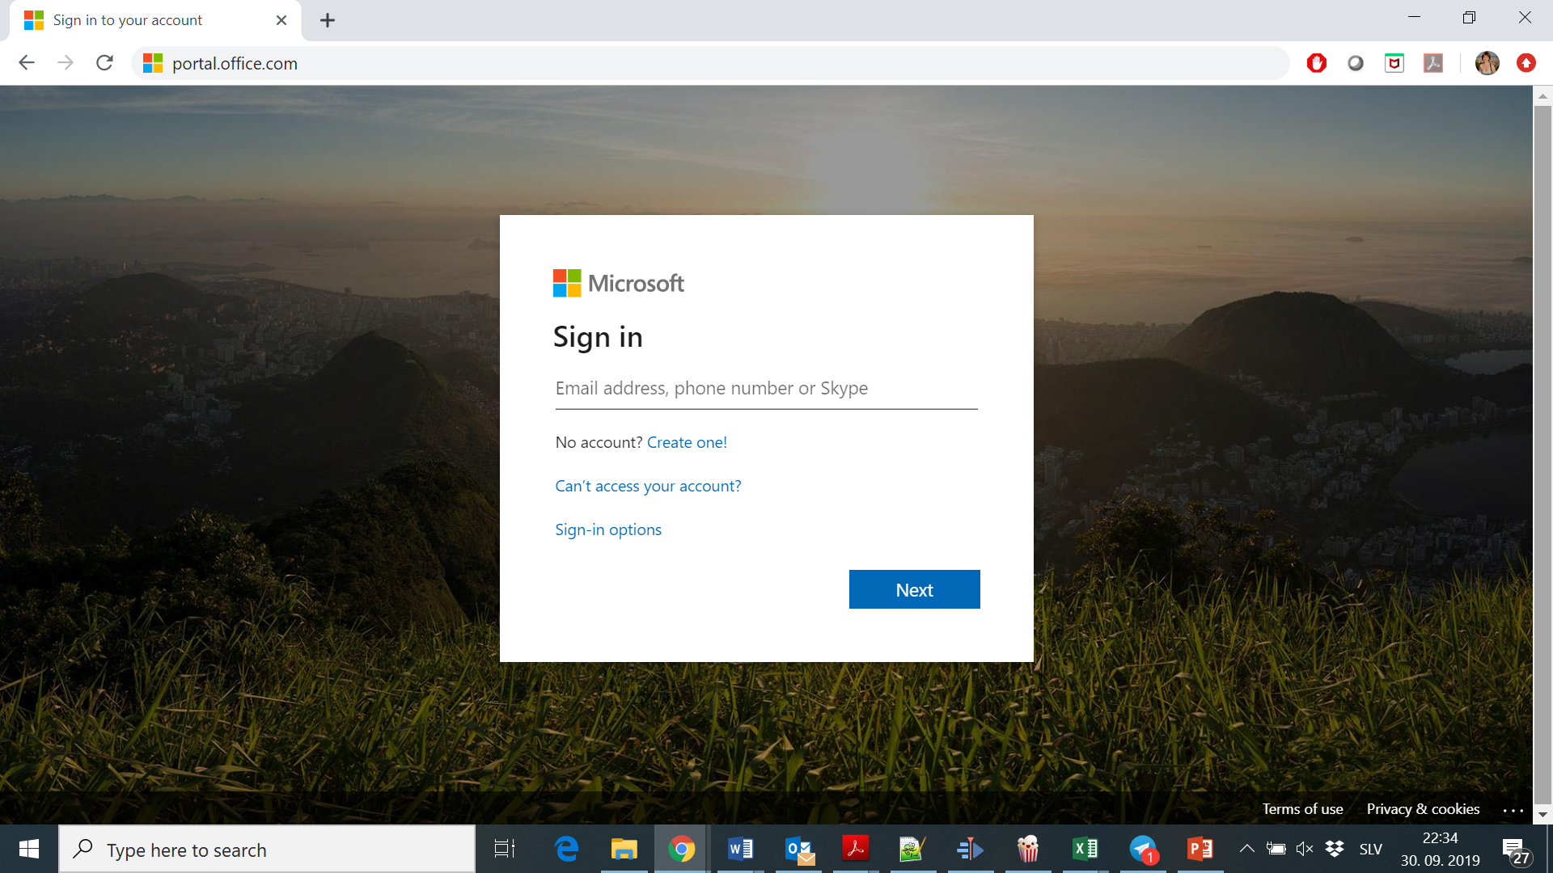
studentID@student.upr.si

Slide 24
Nastavitve za poštne odjemalce / Settings for email clients
Mozilla Thunderbird
MS Outlook
K-9
Gmail
…
Email Provider | IMAP Settings | POP Settings | SMTP Settings
Office 365 | Server: outlook.office365.com Port: 993 Encryption: SSL/TLS | Server: outlook.office365.com Port: 995 Encryption: SSL/TLS | Server: smtp.office365.com Port: 587 Encryption: STARTTLS

Slide 25
Dodatno / In addition
Poskusite, če deluje ZDAJ! Pošljite si e-pošto iz vašega zasebnega e-naslova na vaš uraden univerzitetni e-naslov in preverite, če je prispela!
Lahko si vzamemo 5 minut za nastaviti odjemalca e-pošte na telefonu, Gmail in/ali druge odjemalece.
Na naslednjih nekaj prosojnicah je primer nastavitve odjemalca Gmail.
Pri korespondenci s predavatelji in asistenti uporabljajte svoj URADEN e-naslov. Zaposleni vam lahko ne odgovorijo na naslov soncejevkopru@gmail.com.
Ko pišete e-pošto predavatelju/asistentu, se predstavite in napišite za kateri predmet gre! Tudi če vas učimo le pri enem predmetu, učimo tudi druge predmete.
Try it out NOW! Send and email from your personal email account to the official university account and check if it arrived.
We can take 5 minutes to set up your e-mail client on your phones, Gmail and/or other clients.
An example of how to set up Gmail client can be found on the next couple of slides.
Use your OFFICIAL e-mail address when contacting lecturers and teaching assistants. We may not respond to you if you write us from thesuninkoper@gmail.com.
Introduce yourself and include the name of the course in question when you write an e-mail! Even if we teach you only one subject, we tech other subjects as well.

Slide 26
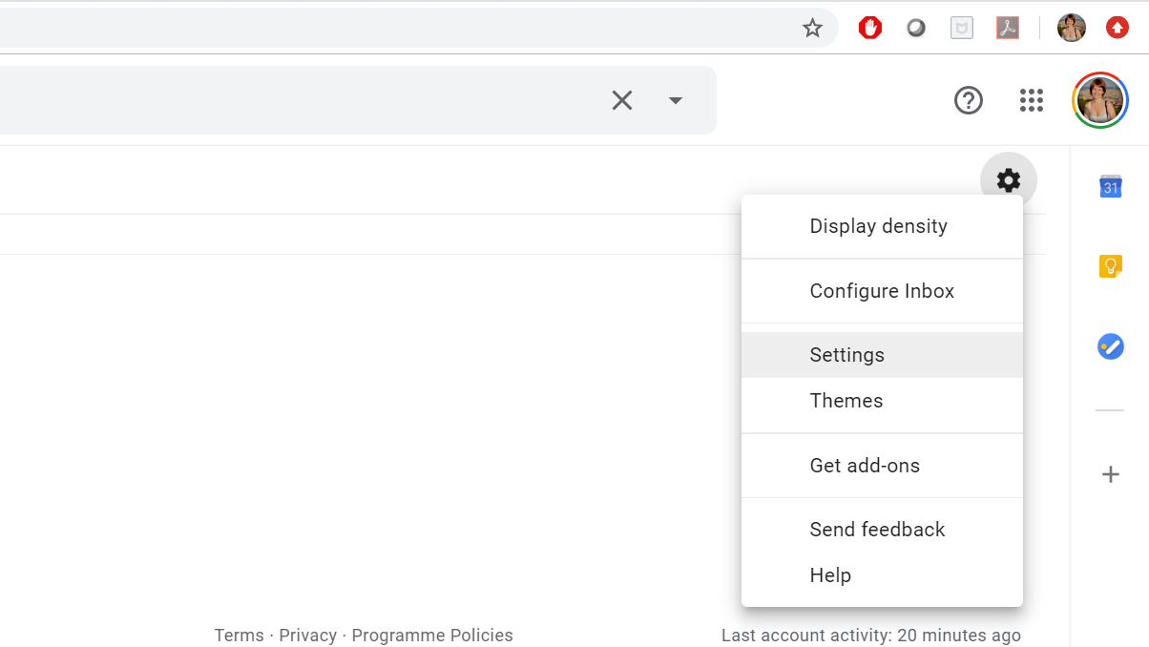
Primer nastavitev v Gmail-u / Gmail settings example

Slide 27
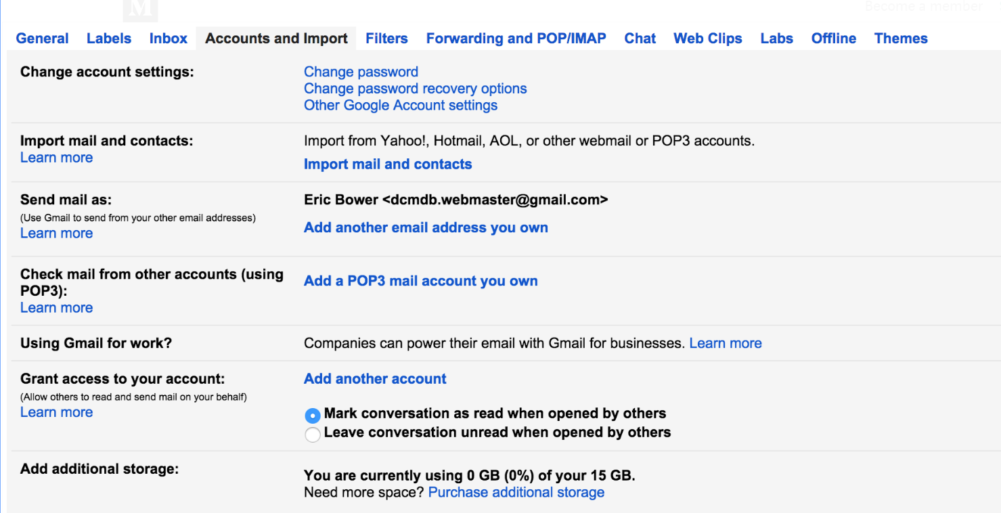

Slide 28
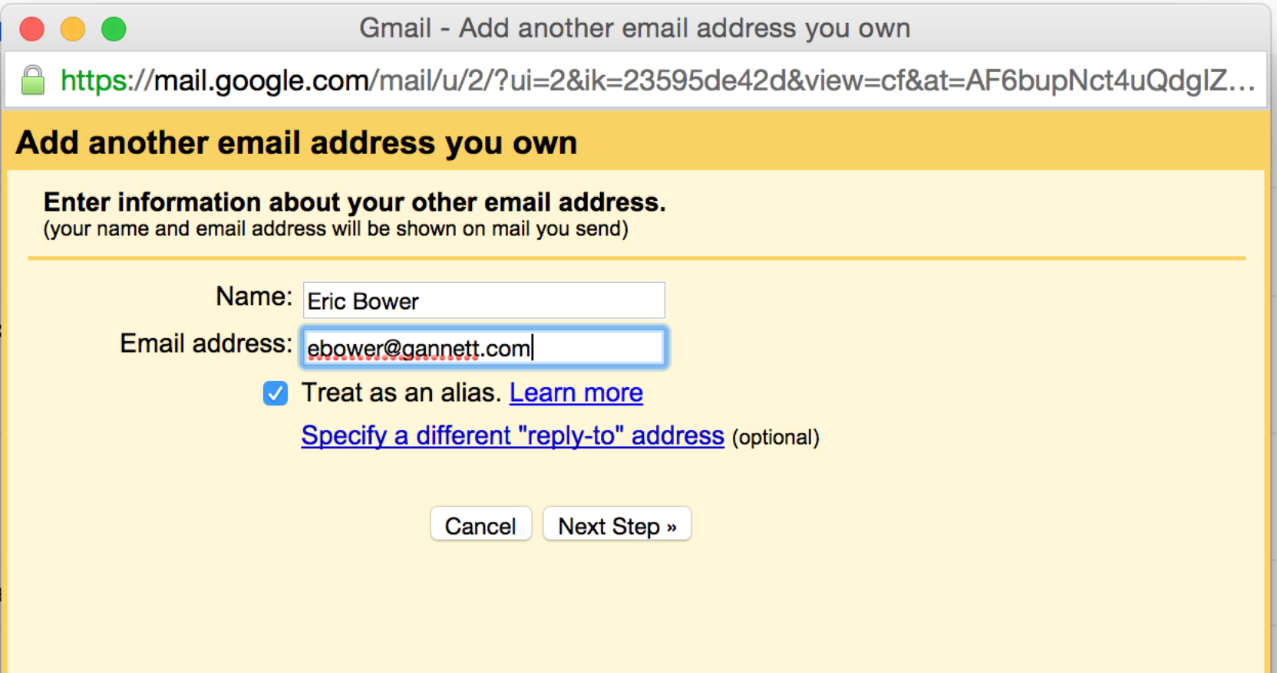
Name Surname
studentID@student.upr.si

Slide 29
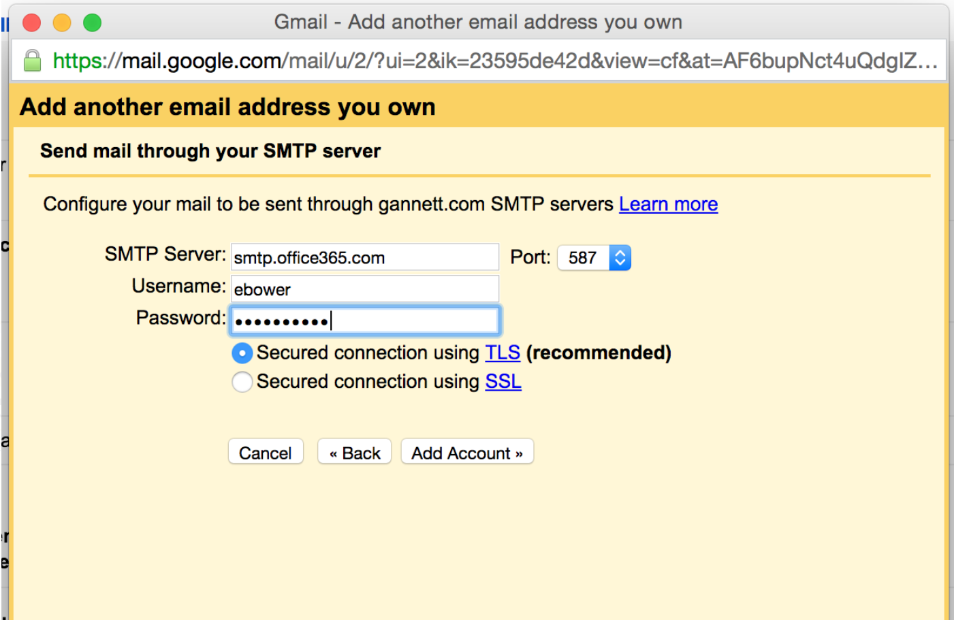
studentID@student.upr.si

Slide 31
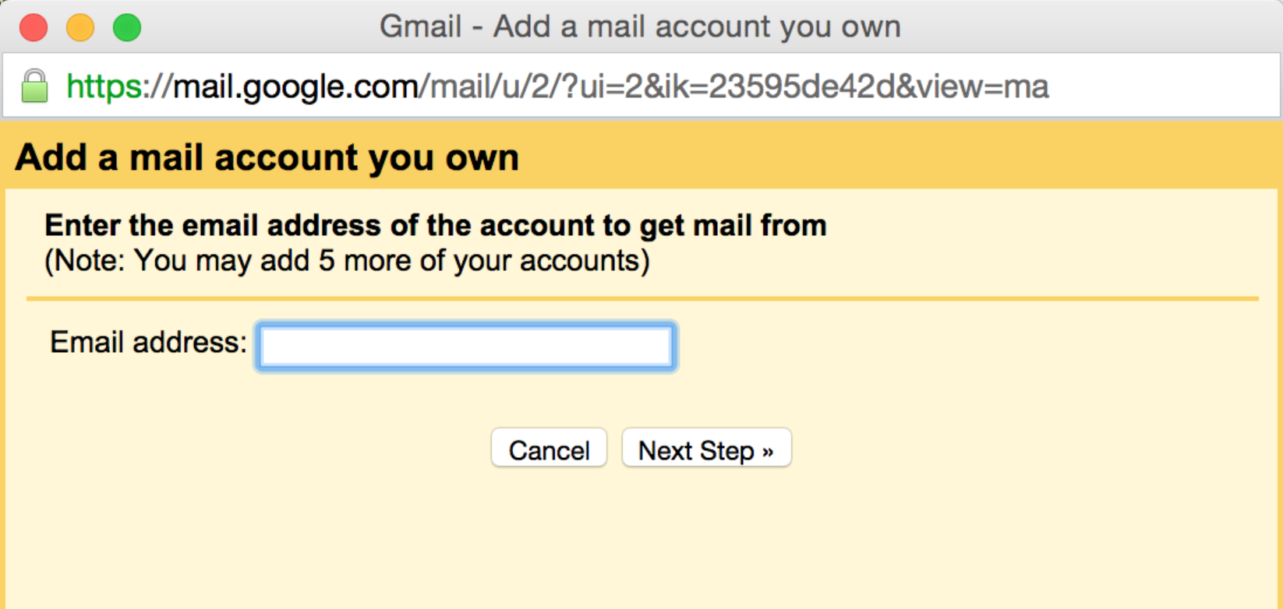
studentID@student.upr.si

Slide 32
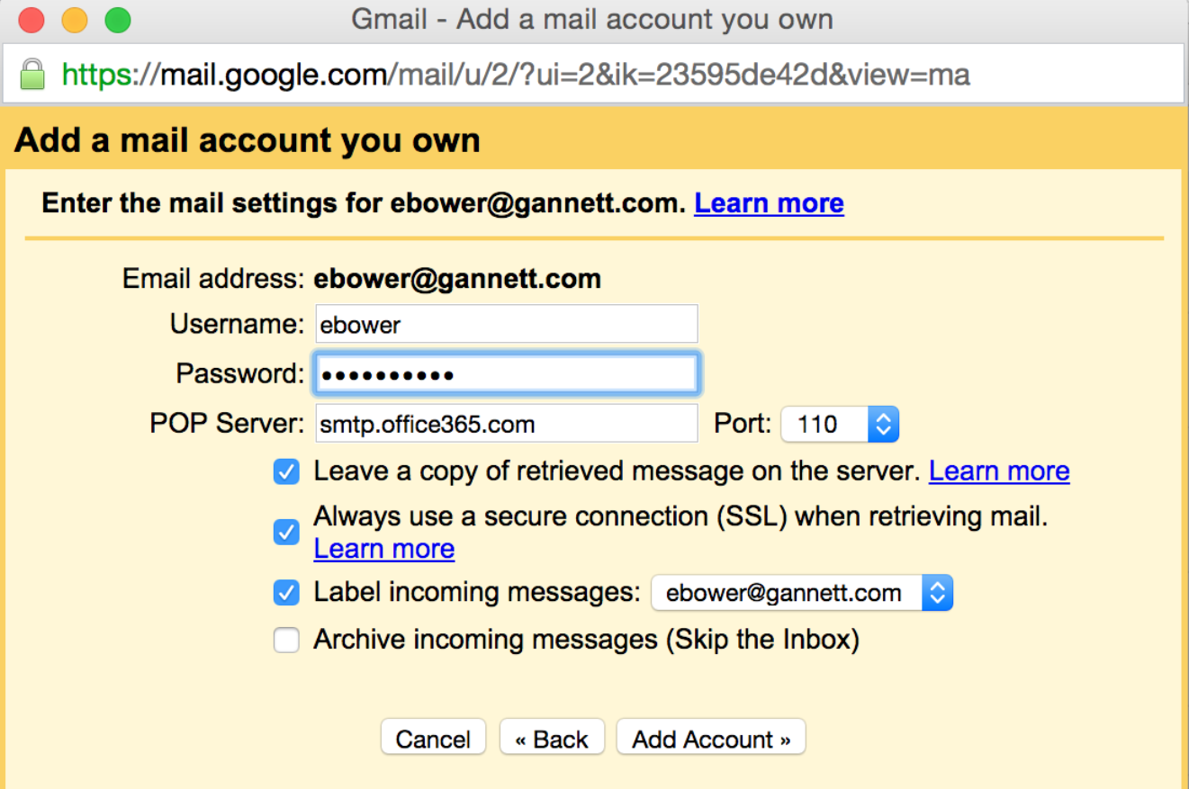
studentID@student.upr.si
studentID@student.upr.si
studentID@student.upr.si
outlook.office365.com
995
studentID@student.upr.si

Slide 33
Brezžično omrežje Eduroam / Eduroam wi-fi
Uporabniško ime: studentID@student.upr.si
Geslo: enako kot prej (za e-mail)
Za ureditev povezave je na večini naprav potrebno namestiti posebno programsko opremo, ki jo dobite na cat.eduroam.org.
Pametni telefon: Snemite in namestite aplikacijo.
Username: studentID@student.upr.si
Password: the same (e-mail)
In order to set up the connection you need to install the software for your device provided on cat.eduroam.org.
Smartphone: Download and install the app.

Slide 34
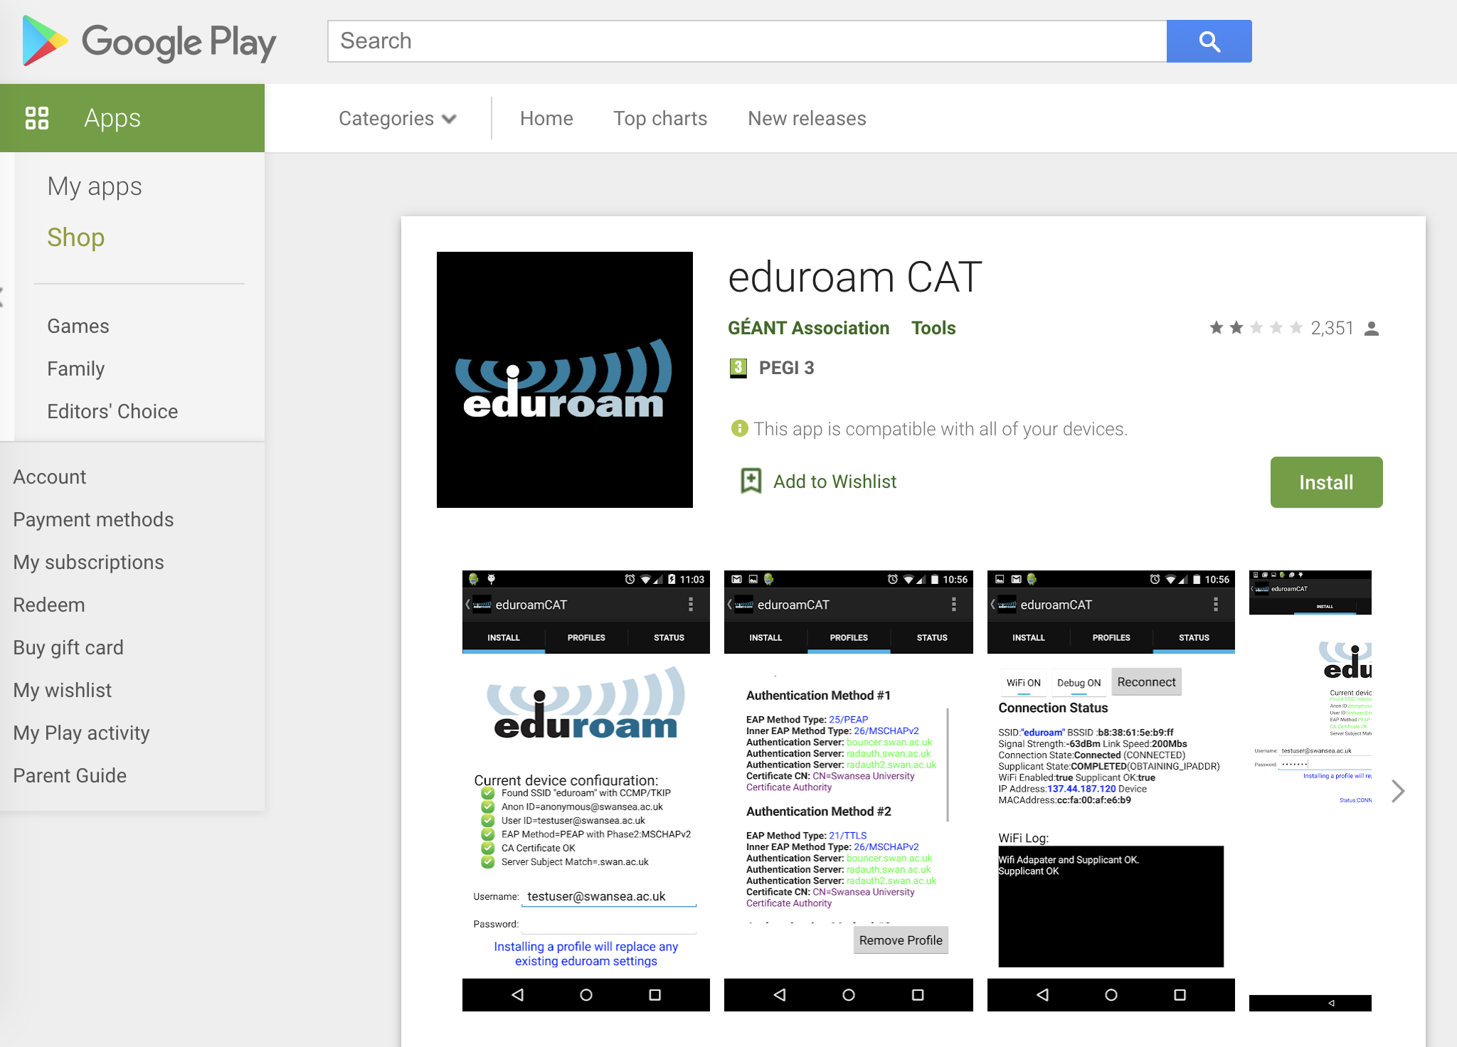
Za Android uporabite:
https://play.google.com/store/apps/details?id=uk.ac.swansea.eduroamcat&hl=en

Slide 35
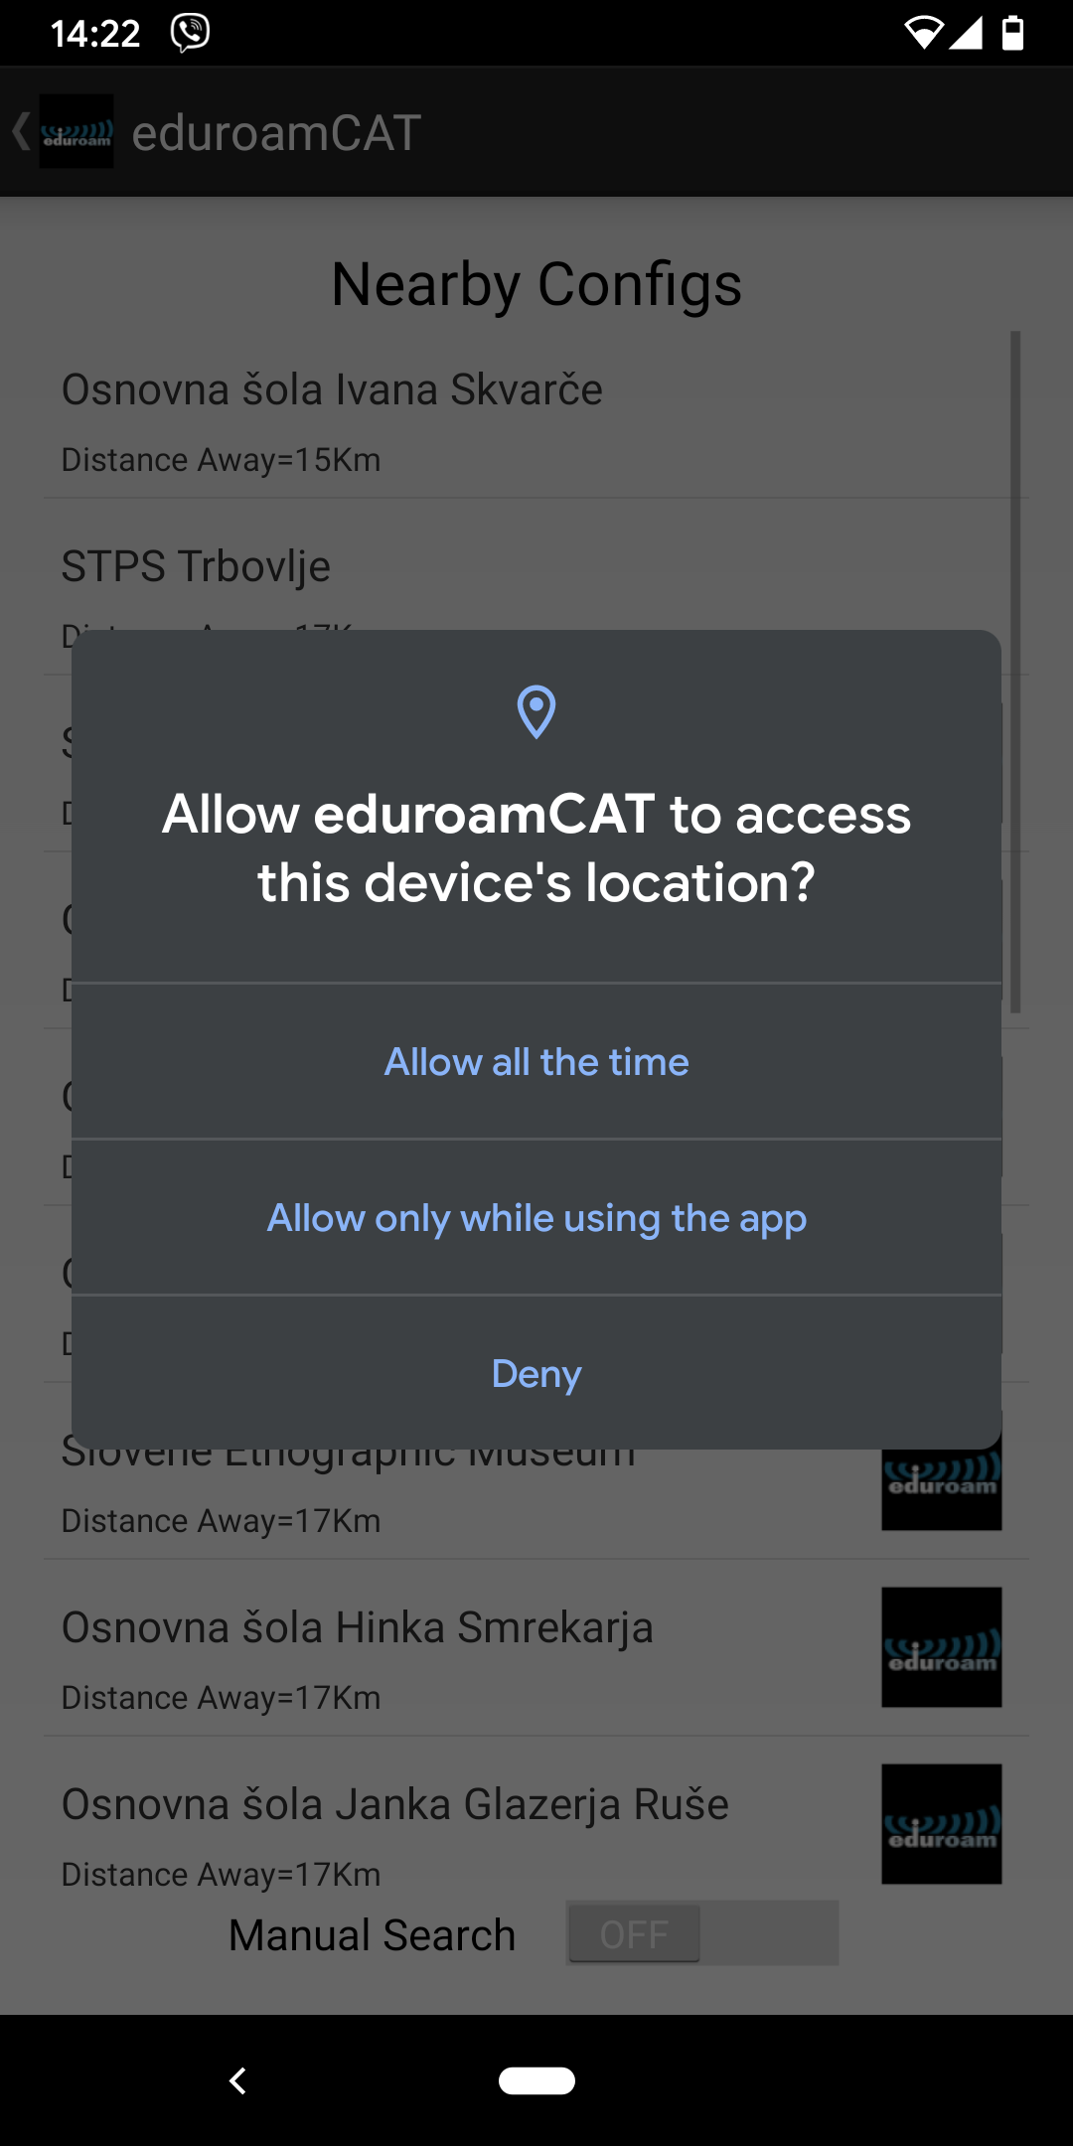
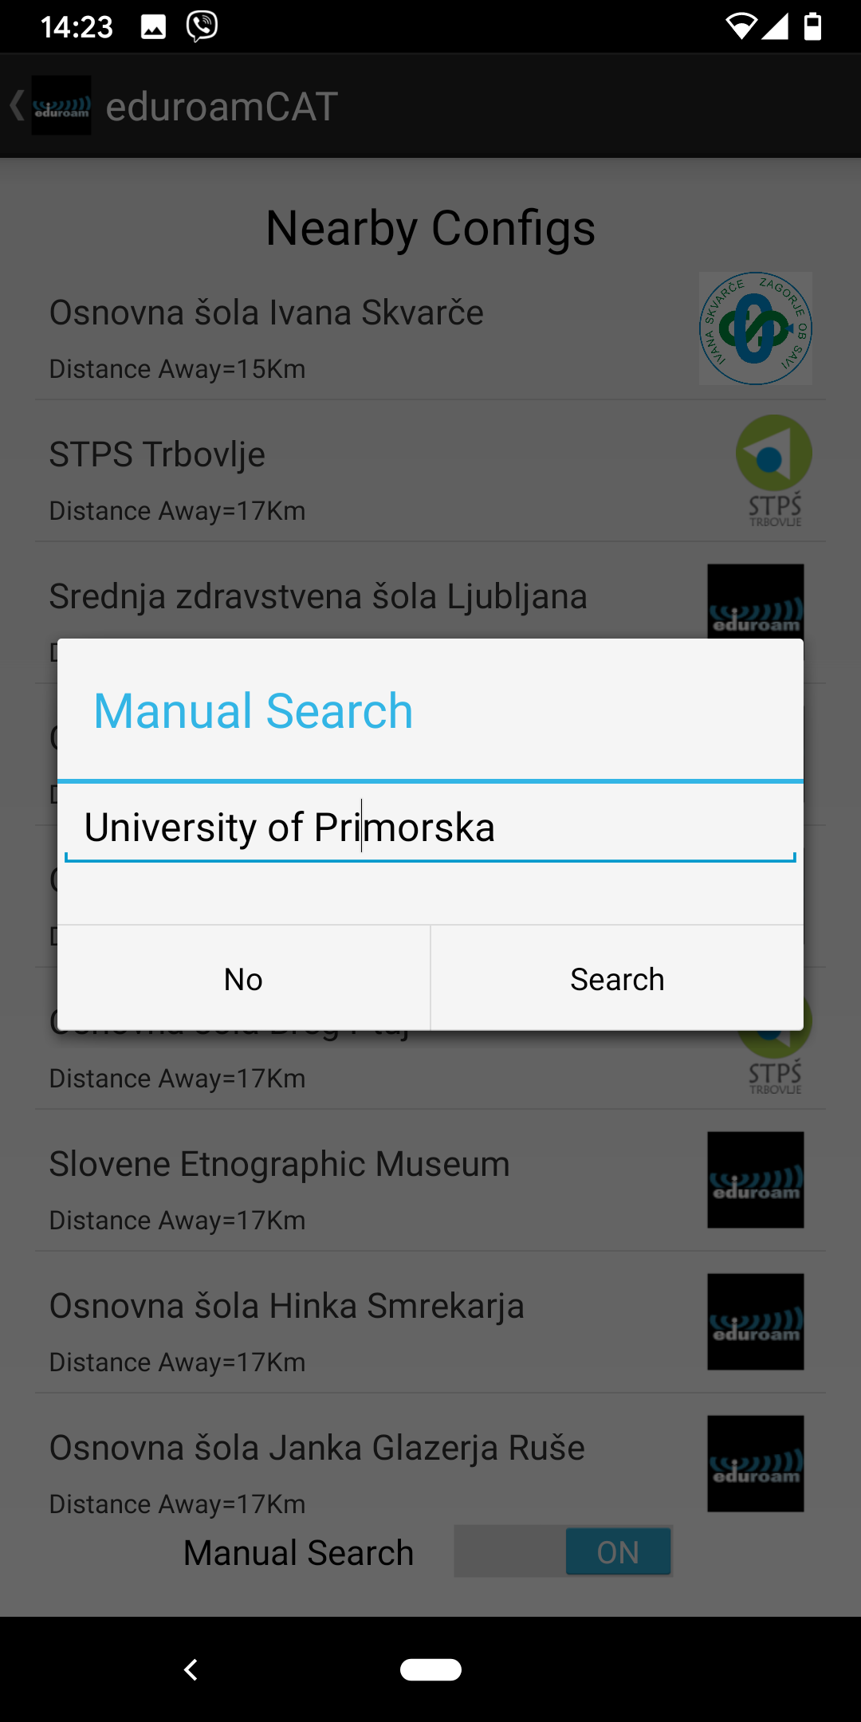
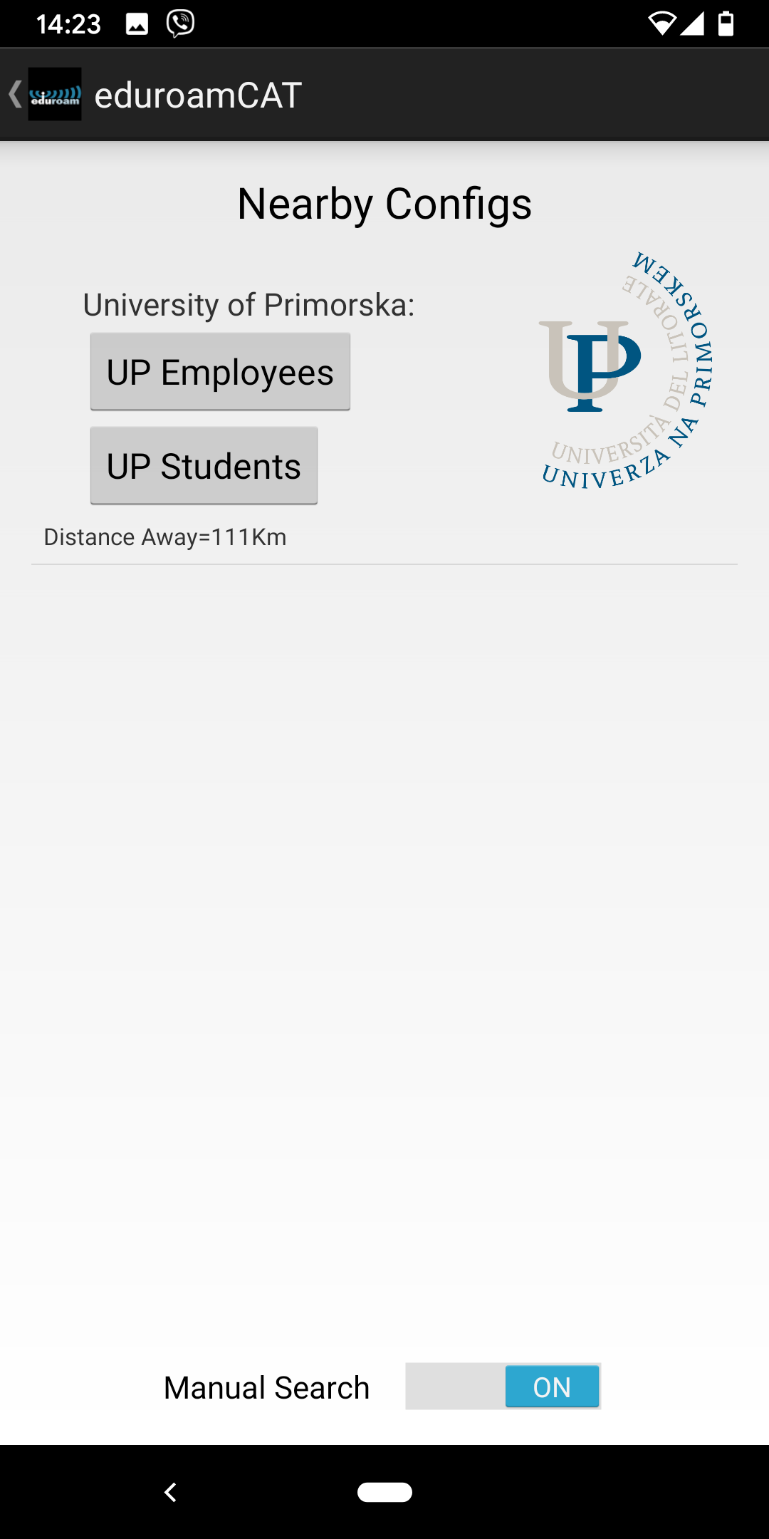
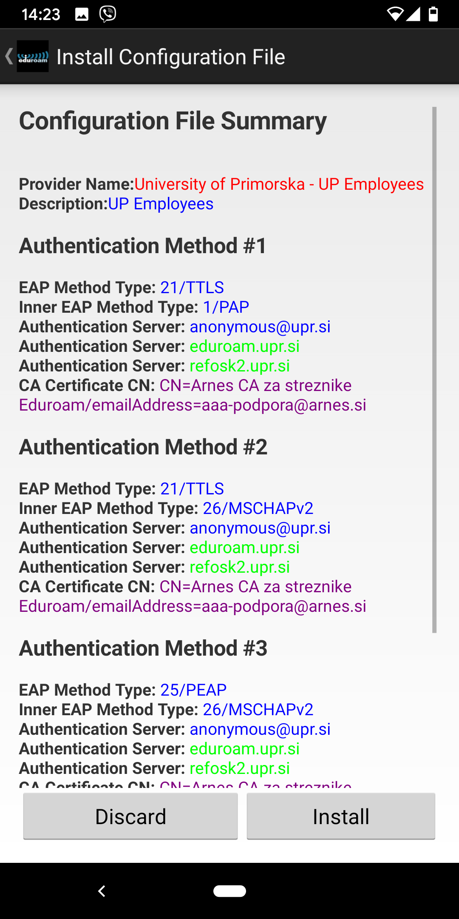
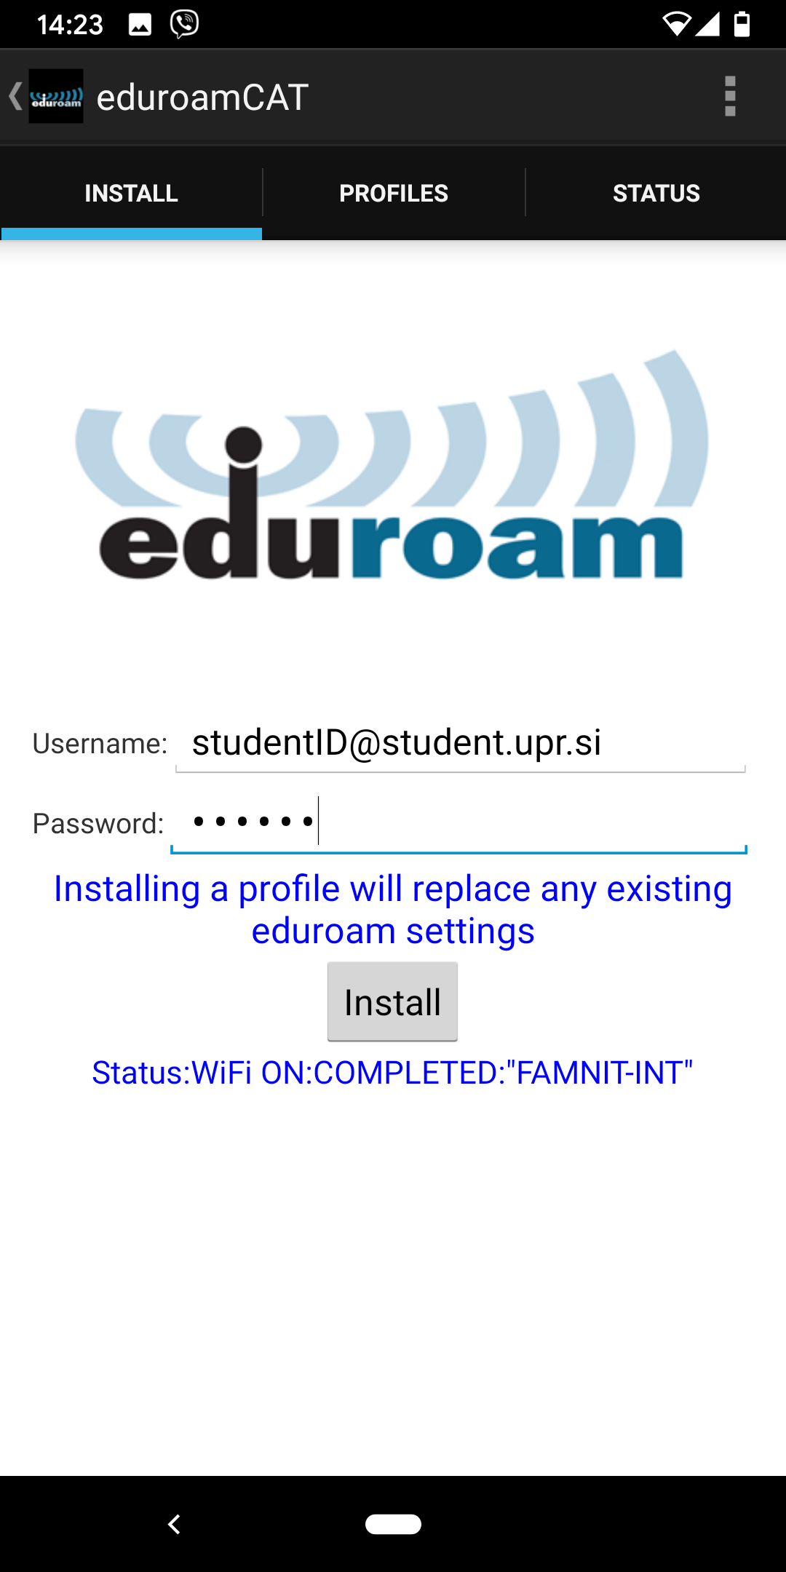
Eduroam CAT Android koraki namestitve / Eduroam CAT Android installation process

Slide 36
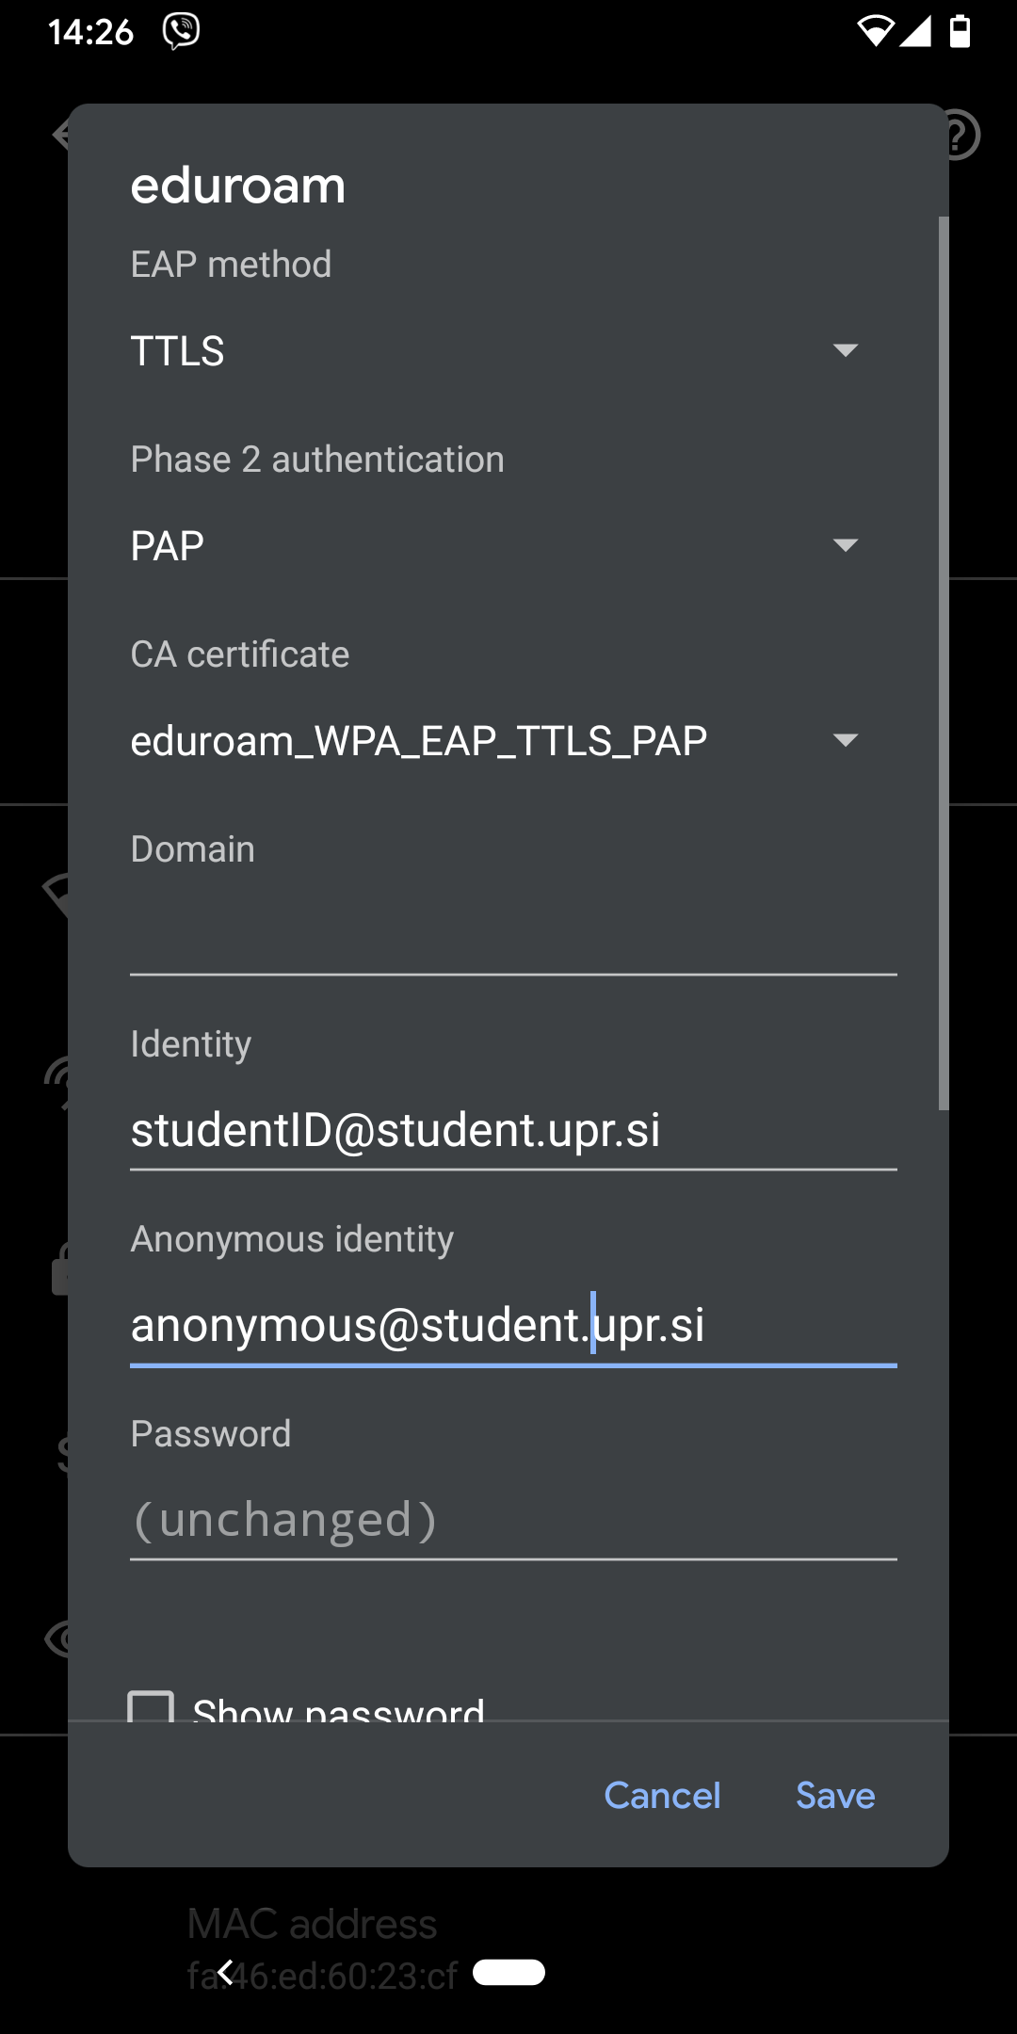
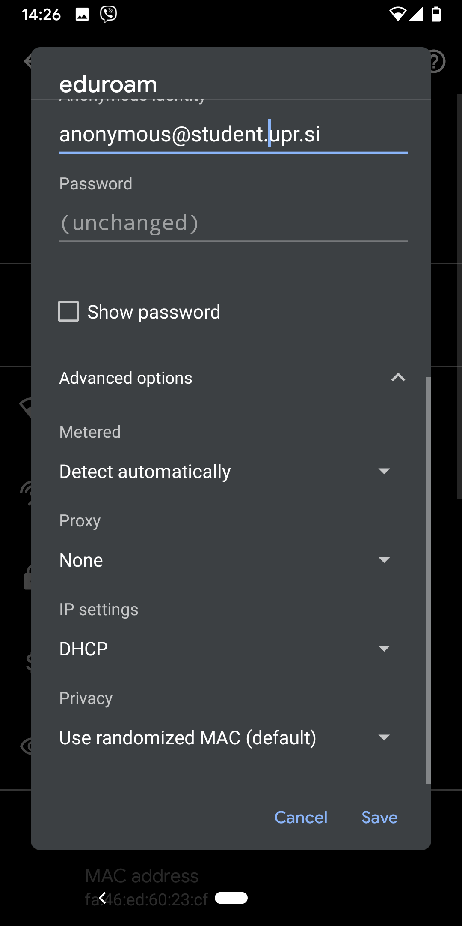
Eduroam Android ročne nastavitve / Eduroam Android manual settings
(unspecified)
https://www.famnit.upr.si//sl/studenti/informacijske-storitve/eduroam-android

Slide 37
Dodatno / In addition
Ne uporabljajte omrežja za nelegalne aktivnosti, ker vam lahko onemogočimo dostop.
Do not use the network for illegal activities as we may block your access.

Slide 38
Arnes AAI
UP je članica federacije Arnes AAI, s čimer študenti dobite dostop do velikega nabora storitev, ki jih nudijo druge organizacije. Primera storitev sta VOX (https://vox.arnes.si/) za izvedbo spletnih konferenc, ali filesender (https://filesender.arnes.si/) za enostavno deljenje velikih datotek
Seznam nekaterih storitev, ki so na voljo preko arnes AAI je na voljo na: https://mds.aai.arnes.si/.
UP is a member of the Arnes AAI Federation, giving students access to a wide range of services provided by other organizations. Examples of services are VOX (https://vox.arnes.si/) for web conferencing, or filesender (https://filesender.arnes.si/) for sharing large files.
A list of some of the services available through the AAI arnes is available at: https://mds.aai.arnes.si/.

Slide 39
Office 365
Office 365 vključuje Outlook (elektronsko pošto), Word, Excel, PowerPoint, OneNote, Microsoft Teams ter nekatere druge microsoftove izdelke.
Dostop do office 365 je mogoč preko spletne strani www.office.com.
Uporabniško ime in geslo je enako kot za elektronsko pošto.
Office 365 includes Outlook (e-mail client), Word, Excel, PowerPoint, OneNote, Microsoft Teams, and some other Microsoft products. Access to office 365 is available through www.office.com. The username and password are the same as for email.

Slide 40
Virtualno zasebno omrežje / Virtual private network VPN
Dostop do virov v študentskem omrežju UP FAMNIT je omogočen študentom z uporabo VPN povezave.
Navodila za dostop so na voljo na spletni strani: https://remote.upr.si/
Access to resources available on the UP FAMNIT Student Network is provided to students using a VPN connection. Access instructions are available at: https://remote.upr.si/

Slide 41
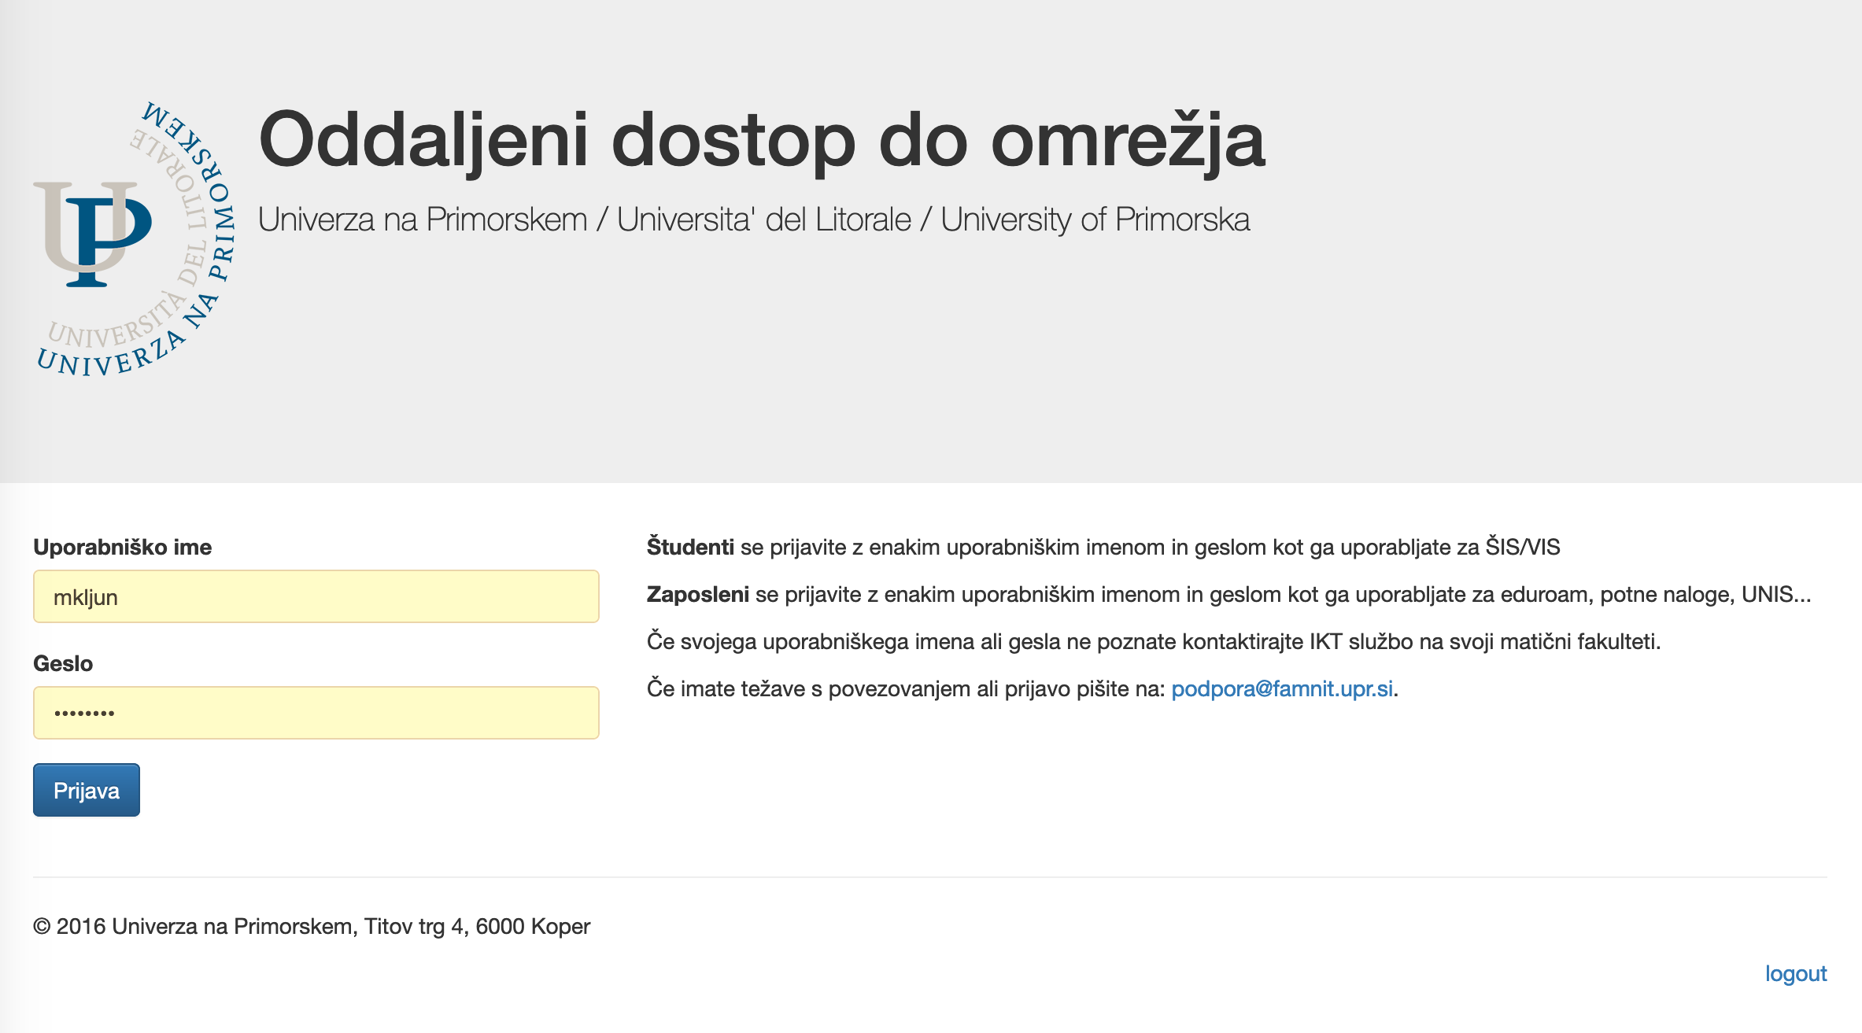
studentID

Slide 42
Obvestila referata / Student office notifications
PRIJAVITE SE na obvestila, ki se vas tičejo in se nanašajo na izvajanje študijskega procesa!
NE OZNAČITI KOT SMETENJE!
Odjavite se.
SUBSCRIBE ONLY to notices that concern you and pertain to the implementation of the study process!
DO NOT MARK AS SPAM! Unsubscribe.
https://www.famnit.upr.si/sl/obvestila

Slide 43
Dodatno / In addition
Če označite pošto v odjemalcu Gmail kot smetenje, onemogočite drugim študentom, da dobivajo obvestila.
Izberite le to kar vas zanima. Če se prijavite na vsa obvestila, boste dobivali veliko obvestil.
Za odjavo od posamezne kategorije novic, sledite navodilom v e-pošti. Je zelo preprosto!
If you mark an email in the Gmail client as spam, you prevent other students from receiving notifications.
Choose what interests you. If you sign up to all notifications, you will get a lot of them.
To unsubscribe from a particular notifications’ category, follow the instructions in the email. It's very simple!

Slide 44
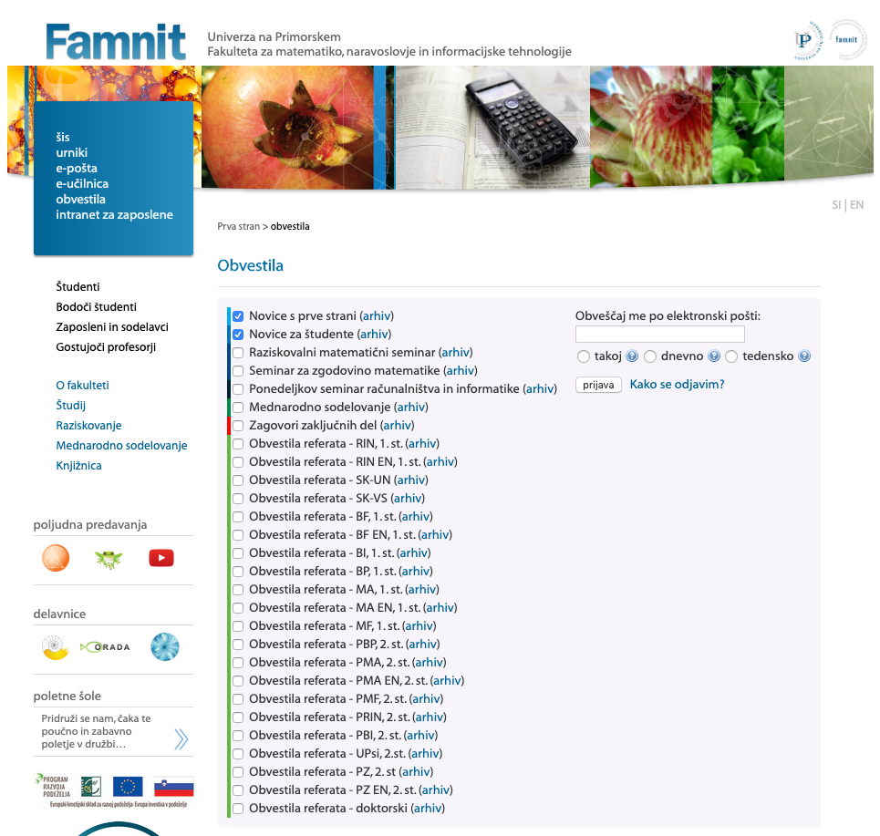
Notifications sent immediately
studentID@student.upr.si
Subscribe
How to unsubscribe

Slide 45
Oddaljeni dostop do vaših datotek in strežnika / Remote access to your files and server
Študenti lahko od doma oz. iz svojih računalnikov dostopate do svojih datotek na fakultetnih strežnikih (diskovnega prostora, ki je na voljo v računalniških učilnicah) preko SSH (SCP oziroma SFTP) povezave na strežnik student.famnit.upr.si.
Datoteke, ki jih ustvarite v računalniških učilnicah lahko prenesete na svoj računalnik ali iz svojega računalnika na strežnik, kar je nato vidno v računalniških učilnicah. Za to so na voljo brezplačni programi: na Windows operacijskih sistemih WinSCP ali FileZilla, na OS X Cyberduck, na Linux pa kar upravljalnik datotek.
Vse kar na tem strežniku postavite v imenik public_html v svojem domačem imeniku (in dovolite dostop uporabniku www-data), bo vidno na naslovu http://student.famnit.upr.si/~studentID.
You can can access tall your files on the faculty servers (disk space that is available in the computer laboratories) via an SSH (SCP or SFTP) connection to the student.famnit.upr.si server from your own computers.
You can download the files you create in the computer classrooms to your computer or from your computer to the server, which can then be available in computer classrooms. Free software is available for this: on Windows WinSCP or FileZilla operating systems, on OS X Cyberduck, and on Linux a regular file manager.
Anything you place on this server in the public_html directory in your home directory (and allow access to the www-data user) will be visible at http://student.famnit.upr.si/~studentID].

Slide 46
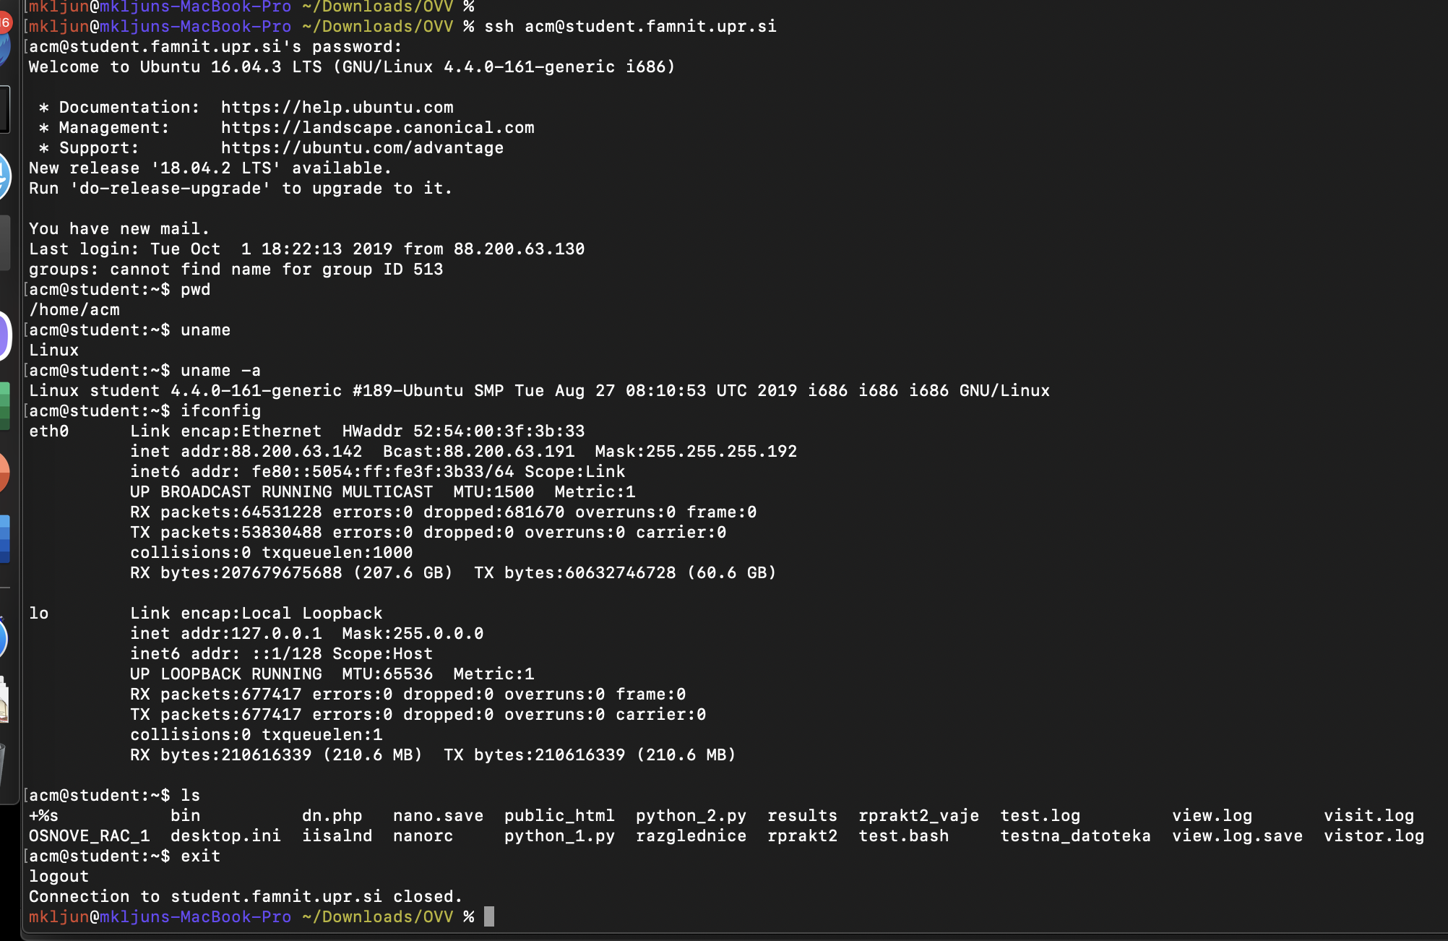
SSH

Slide 47
Dodatno / In addition
Poskusite zdaj. Odprite terminal in se prijavite na študentski strežnik.
Try it now. Open a terminal and log in to the student server.

Slide 48
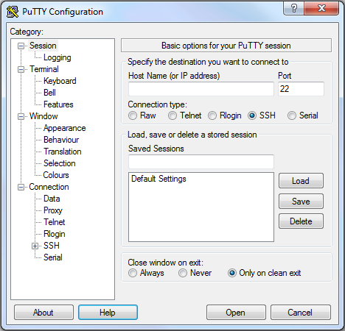
SSH na Windows OS / SSH on Windows
https://www.putty.org/
Alternative: / Alternatives:
Solar-Putty
KiTTY
MobaXterm
mRemoteNG
Xshell 6 Client
Bitvise
PuttyTray
SuperPutty
student.famnit.upr.si

Slide 49
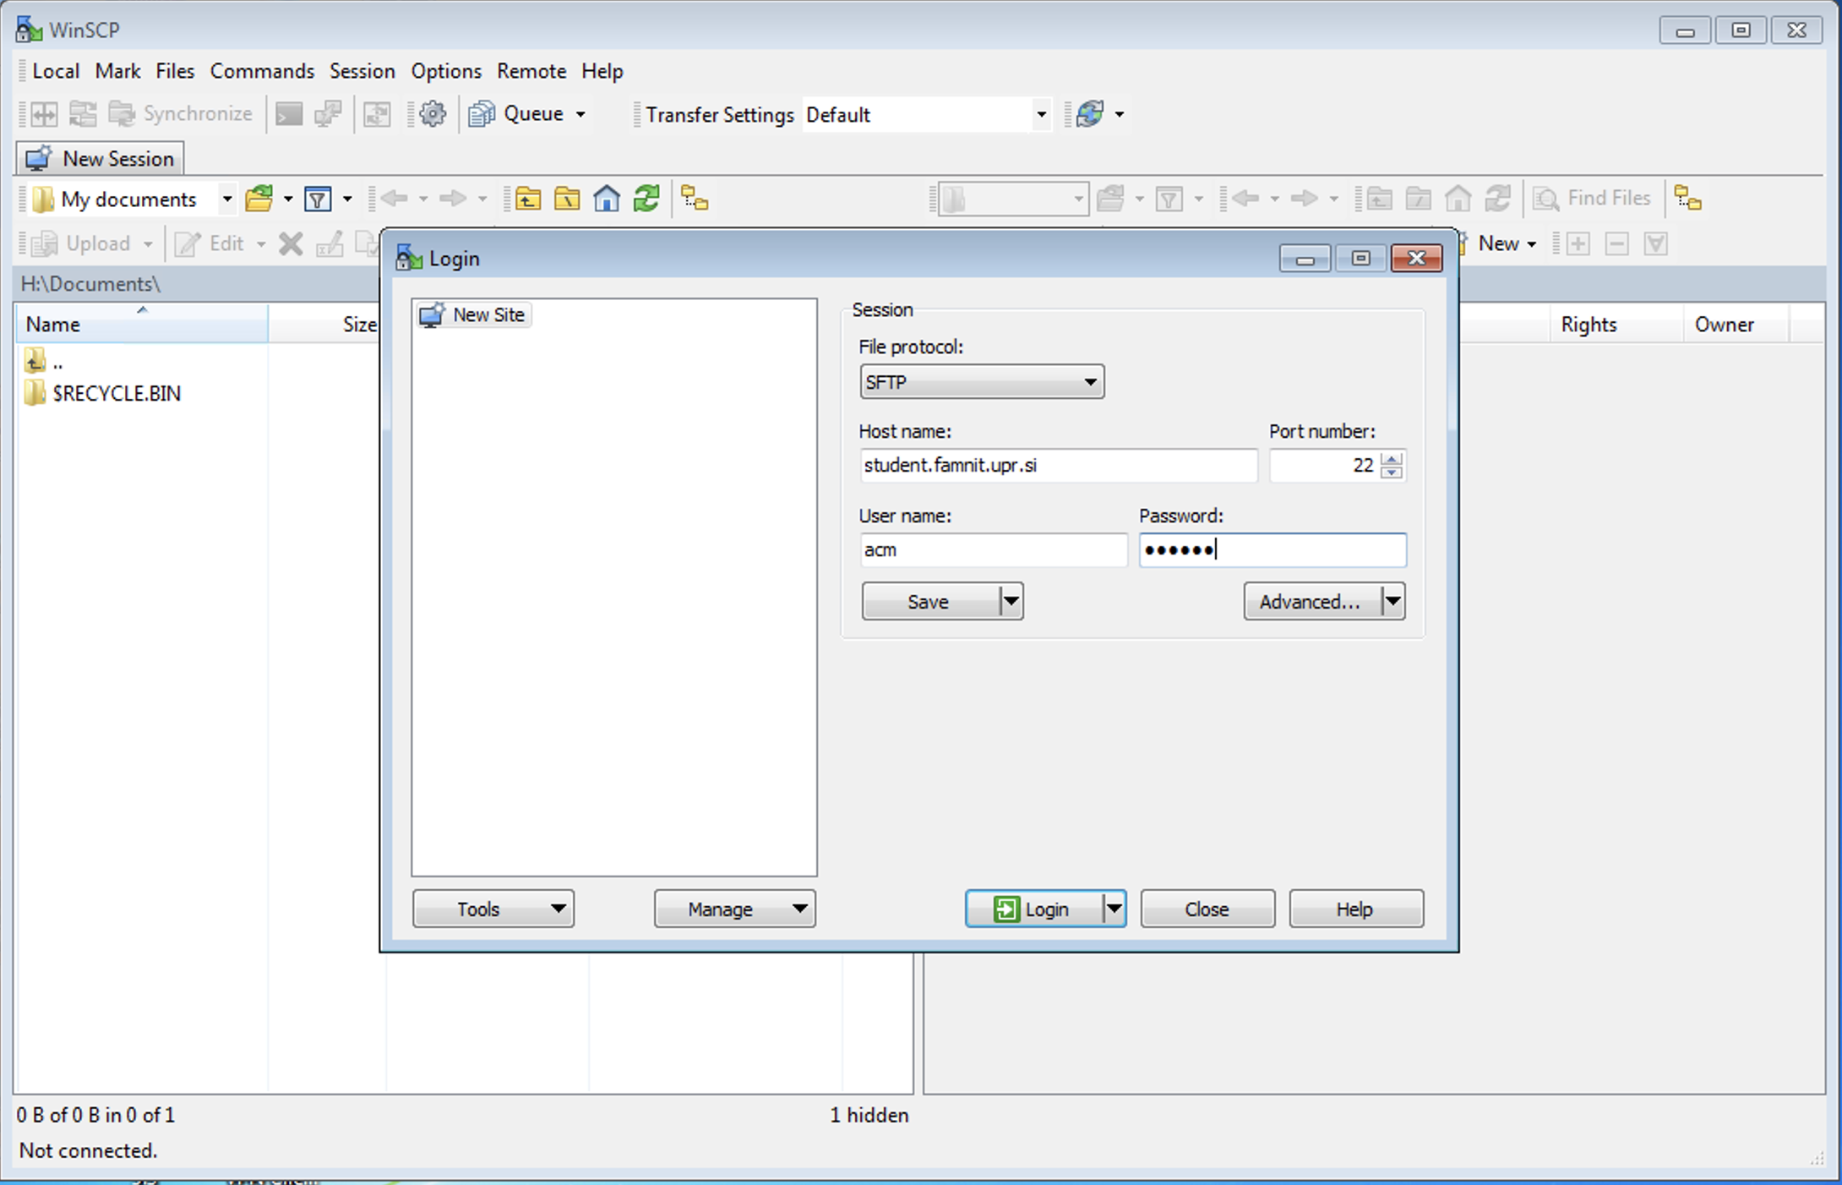
WinSCP
studentID

Slide 50
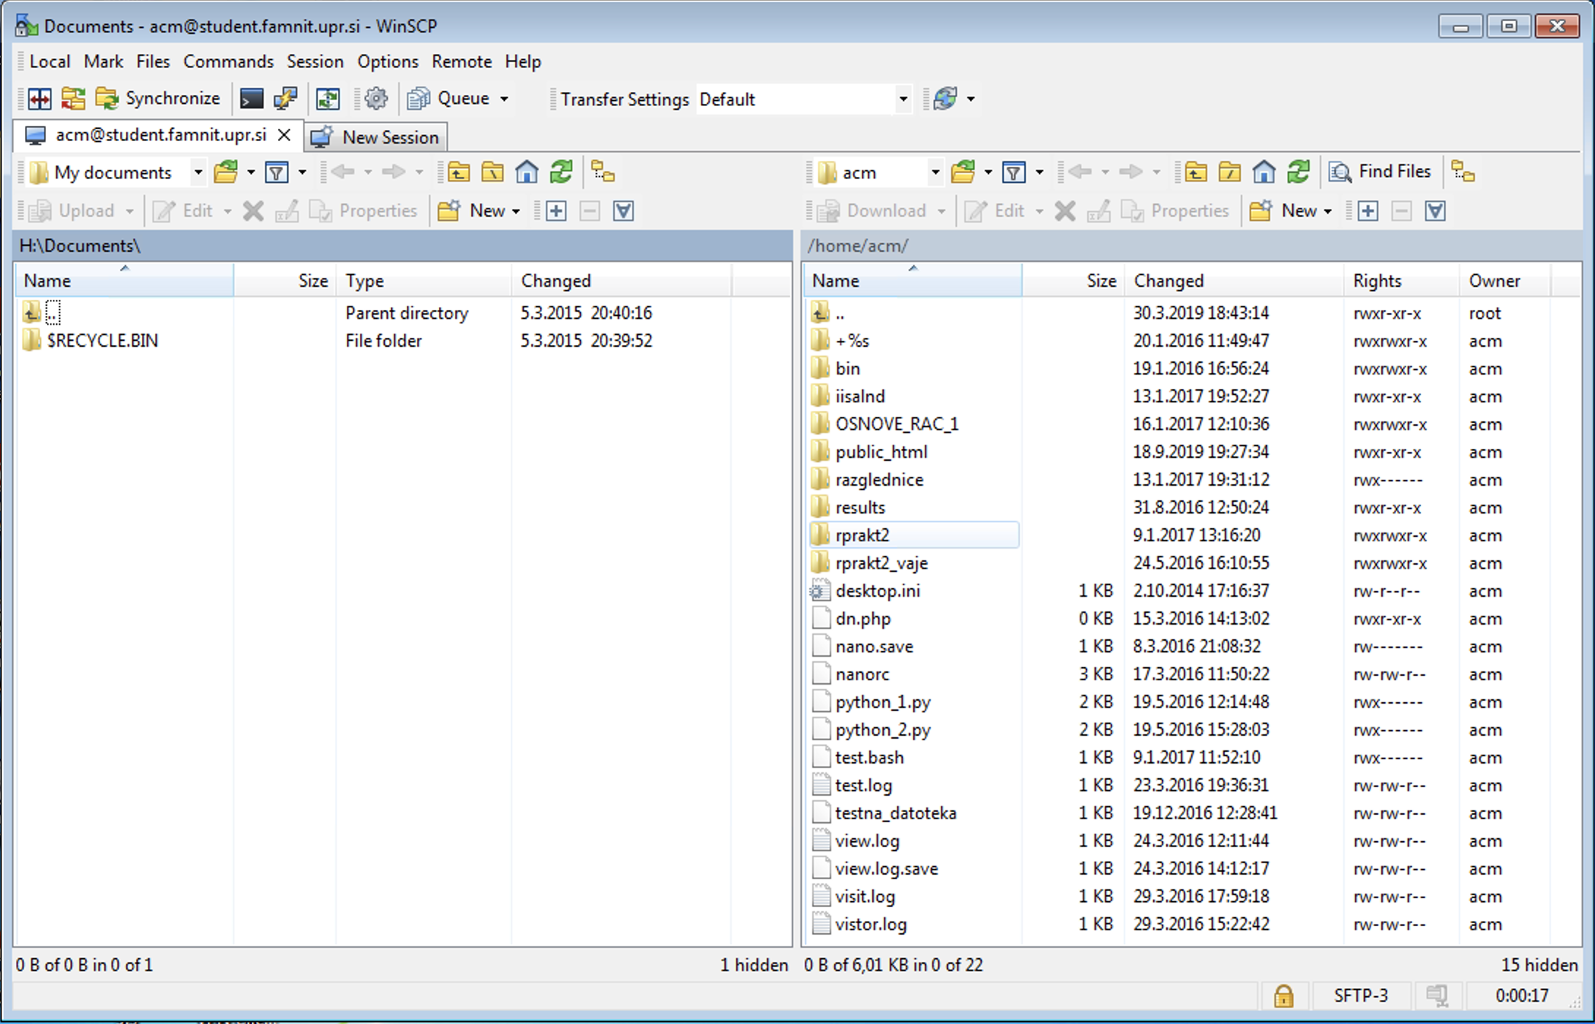

Slide 51
E-učilnica / E-classroom
https://e.famnit.upr.si/
Uporabniško ime/geslo: enako kot za e-mail
TAKOJ se vpišite v vse predmete, ki jih imate!
Splošne informacije o predmetih,
obvestila izvajalcev,
gradiva za predmete,
domače naloge, kvizi, kolokviji, izpiti,
ocene,
forum za vprašanja in odgovore, obvestila, razprave.
https://e.famnit.upr.si/
Username/Password: Same as for E-mail
IMMEDIATELY sign up for any courses you follow!
General information about courses,
notices from lecturers,
materials for the course,
homework, quizzes, tests, exams,
grades,
forum for questions and answers, announcements, discussions.

Slide 52
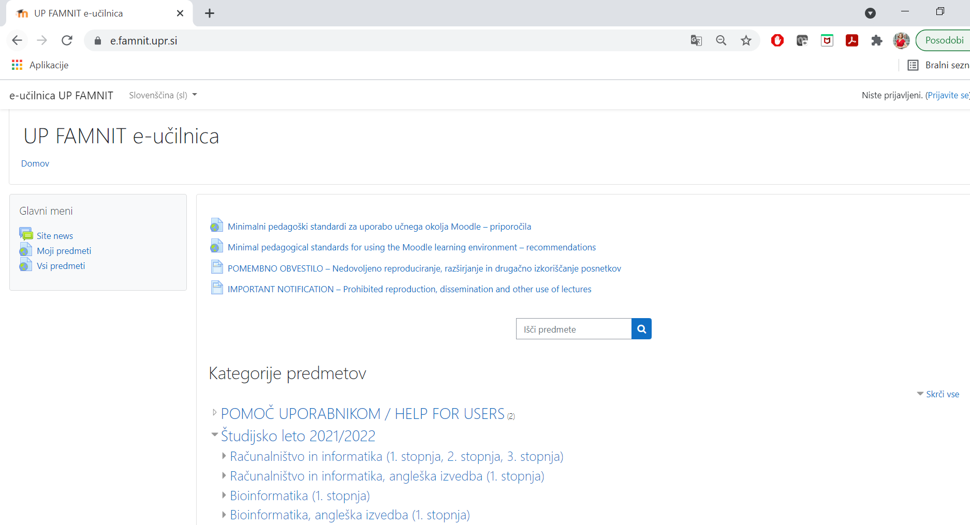

Slide 53
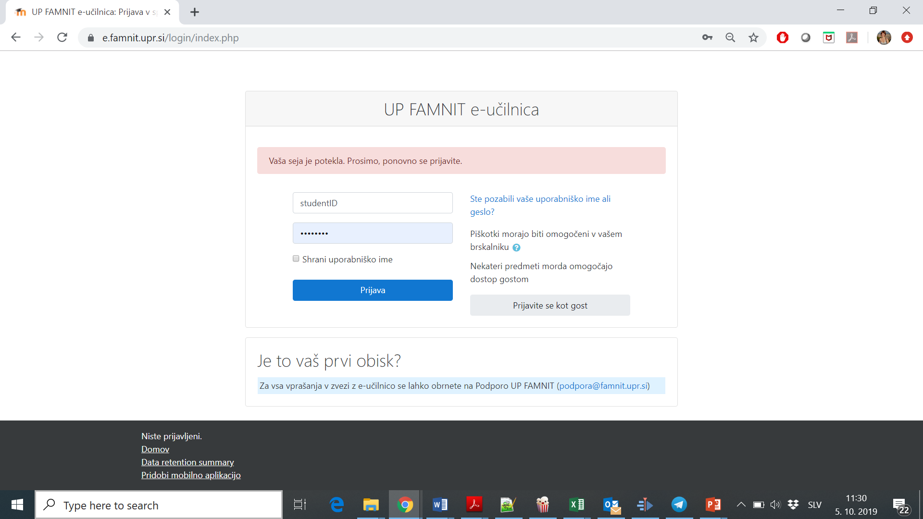

Slide 54
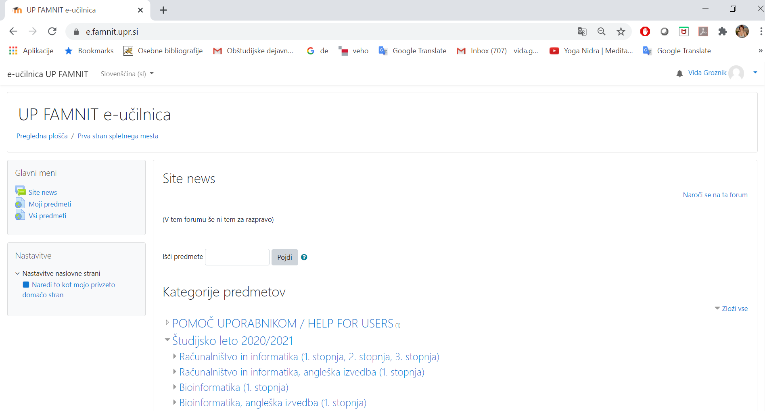

Slide 55
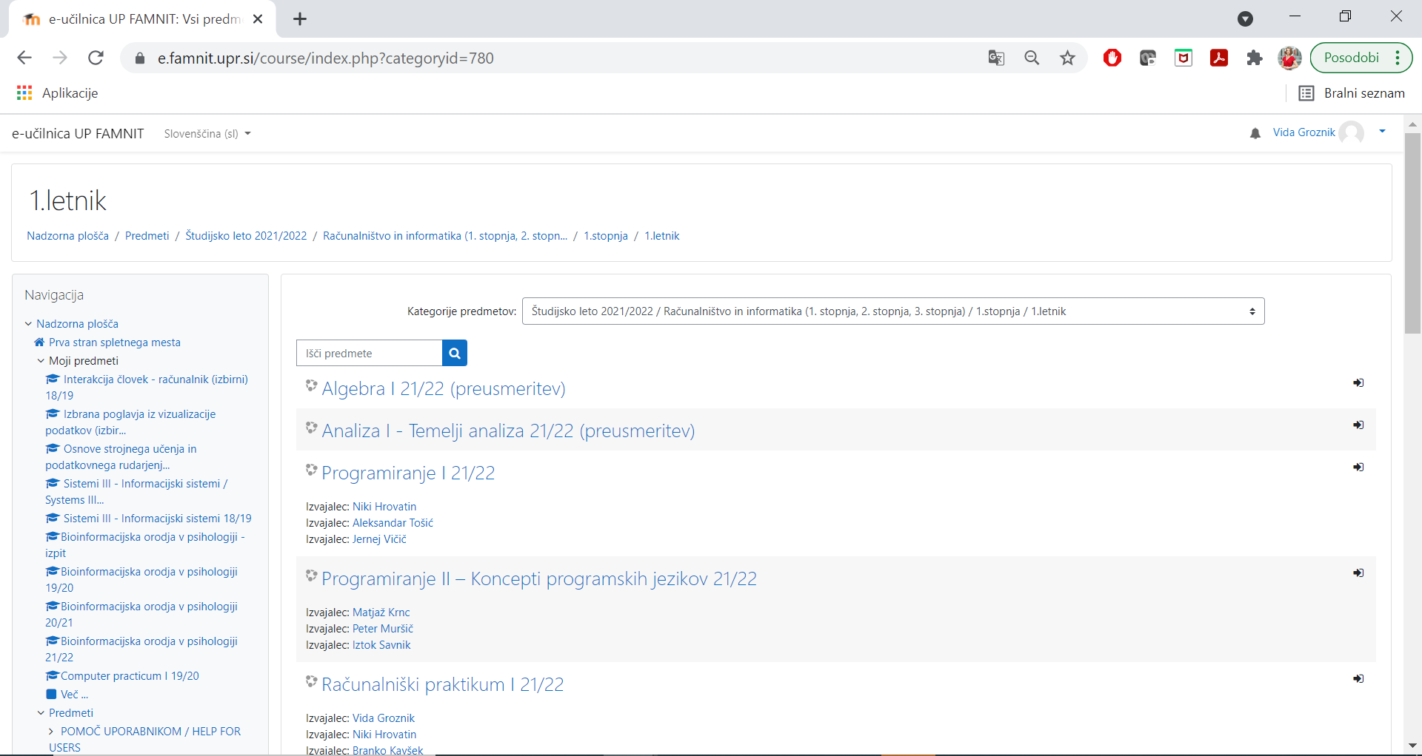

Slide 56
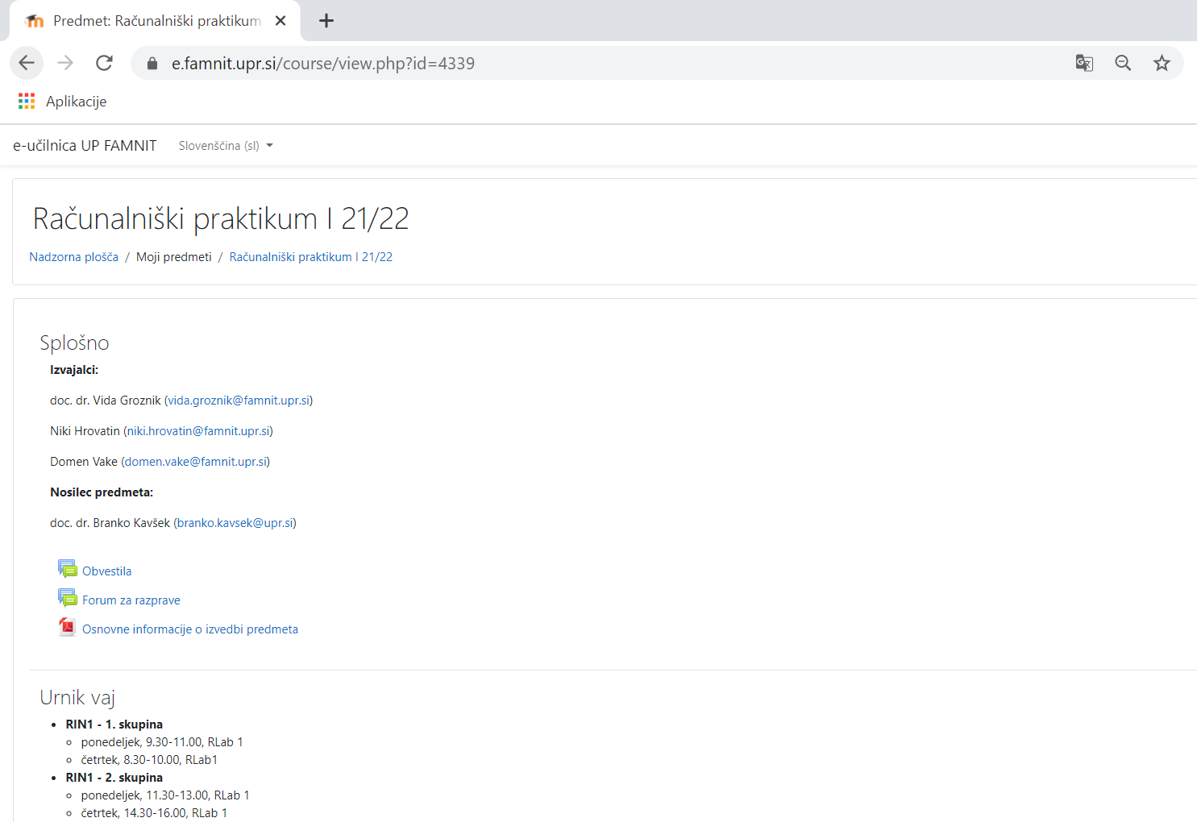

Slide 58
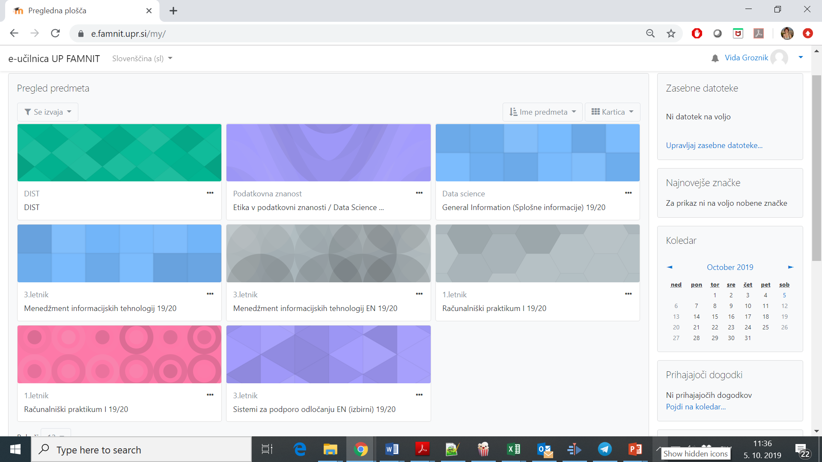

Slide 59
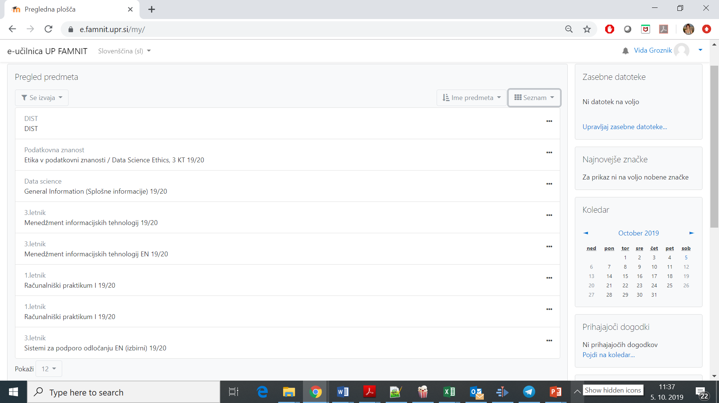

Slide 60
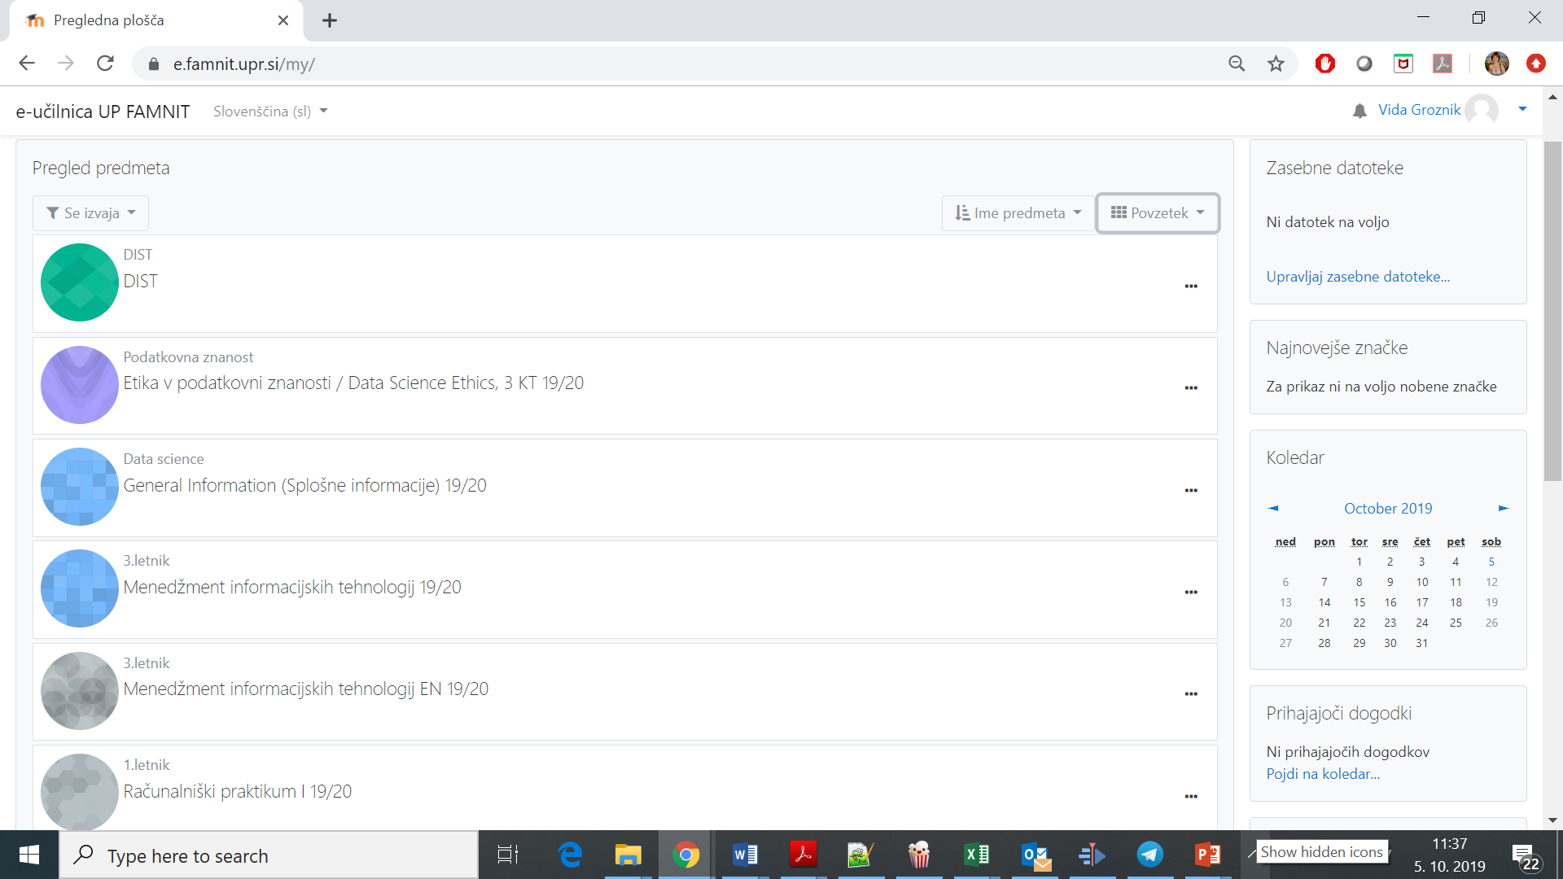

Slide 61
ZOOM - https://zoom.us/
Vsi študenti imate na voljo polno licence Zoom, če se prijavite z univerzitetnim e-naslovom.
Prednosti:
Študenti, ki so prijavljeni z univerzitetno e-naslovom, lahko preskočijo čakalnico, če je spletna učilnica tako nastavljena.
Študenti lahko gostite sestanke brez 40 minutne omejitve, če želite imeti spletne video pogovore z vrstniki, prijatelji, družino…
All students have a full Zoom licence if you sign in with your university email address.
Advantages:
Students who are signed in with university email can skip the Waiting Room if the online classroom is set this way.
Host a meeting without 40 minutes limit to have online video sessions with your peers, friends, family …

